Slide 1
Spring MVC

Slide 2
Objectives
Spring MVC Basics
Spring MVC Framework
Controller/Model/View
Spring Interceptor
Spring Validator

Slide 3
The MVC pattern
MVC pattern breaks an application into three parts:
Model: The domain object model / service layer
View: Template code / markup
Controller: Presentation logic / action classes
MVC defines interaction between components to promote separation of concerns and loose coupling
Each file has one responsibility
Enables division of labor between programmers and designers
Facilitates unit testing
Easier to understand, change and debug

Slide 4
Advantages of MVC Pattern
Separation of application logic and web design through the MVC pattern
Integration with template languages
Some MVC frameworks provide built-in components
Other advantages include
Form validation
Error handling
Request parameter type conversion
Internationalization
IDE integration

Slide 5
Exploring Spring's Web MVC Framework
The Spring Web MVC framework is built on generic Servlet known as a DispatcherServlet class (Front Controller).
The DispatcherServlet class sends the request to the handlers with configurable handler mappings, theme resolution, locale and view resolution along with file uploading.
The handleRequest(request, response) method is given by the default handler called Controller interface.
The application controller implementation classes of the controller interface are as follows:
AbstractController
AbstractCommandController
SimpleFormController.

Slide 6
Spring MVC Features
Powerful configuration of both framework and application classes.
Separation of roles.
Flexibility in choosing subclasses.
Model transfer flexibility.
No need of duplication of code.
Specific validation and binding.
Specific local and theme resolution.
Facility of JSP form tag library.

Slide 7
Spring Web MVC
Spring Web MVC is the original web framework built on the Servlet API and has been included in the Spring Framework from the very beginning.
The formal name, "Spring Web MVC," comes from the name of its source module (spring-webmvc), but it is more commonly known as "Spring MVC".

Slide 8
Spring Web MVC
DispatcherServlet
Filters
Annotated Controllers
Functional Endpoints
URI Links
Asynchronous Requests
CORS
Error Responses
Web Security
HTTP Caching
View Technologies
MVC Config
HTTP/2

Slide 9
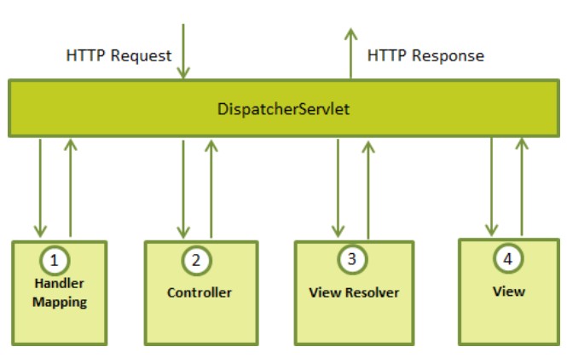
DispatcherServlet

Slide 10
DispatcherServlet
Following is the sequence of events corresponding to an incoming HTTP request to DispatcherServlet
After receiving an HTTP request, DispatcherServlet consults the HandlerMapping to call the appropriate Controller.
The Controller takes the request and calls the appropriate service methods based on used GET or POST method. The service method will set model data based on defined business logic and returns view name to the DispatcherServlet.
The DispatcherServlet will take help from ViewResolver to pickup the defined view for the request.
Once view is finalized, The DispatcherServlet passes the model data to the view which is finally rendered on the browser.

Slide 11
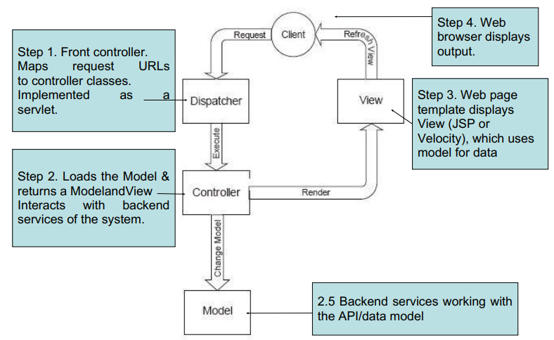
DispatcherServlet
HandlerMapping, Controller, and ViewResolver are parts of WebApplicationContext which is an extension of the plain ApplicationContext with some extra features necessary for Web applications.

Slide 12
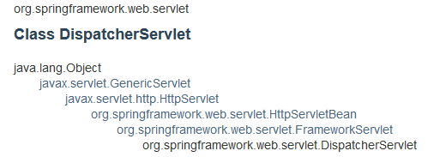
DispatcherServlet
The DispatcherServlet class is important part of spring Web MVC framework.
It is used for dispatching the request to application controllers.
The DispatcherServlet class is configured in web.xml file of a web application.
Map the request using Uniform Resource Locator (URL) mapping in the same web.xml file to handle any request

Slide 13
HadlerMapping/Controller/ViewResolver
Handler mapping: Manages the execution of controllers, provided they match the specified criteria.
Controller: It handles the client's request.
View resolver: Resolves view names to view used by the DispatcherServlet.
The mapping between the Logical name and the Physical View Location is taken care by the View Resolver object.
Spring comes with a set of Built-In Spring Resolvers.
We can write Custom View Resolvers by implementing the org.springframework.web.servlet.ViewResolver interface

Slide 14
View Resolver
InternalResourceViewResolver
ContentNegotiatingViewResolver
BeanNameViewResolver
FreeMarkerViewResolver
JasperReportsViewResolver
ResourceBundleViewResolver
UrlBasedViewResolver
VelocityLayoutViewResolver
VelocityViewResolver
XmlViewResolver
XsltViewResolver

Slide 15
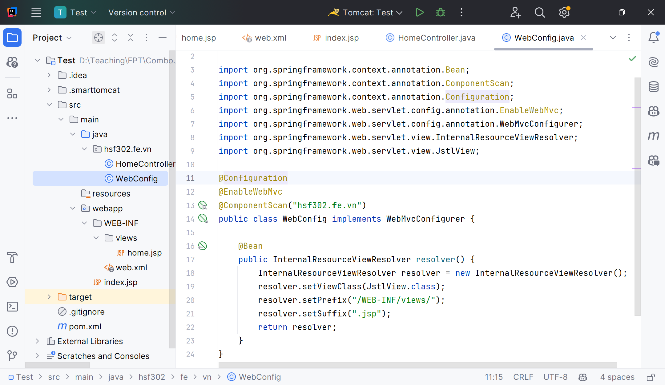
View Resolver
InternalResourceViewResolver

Slide 16
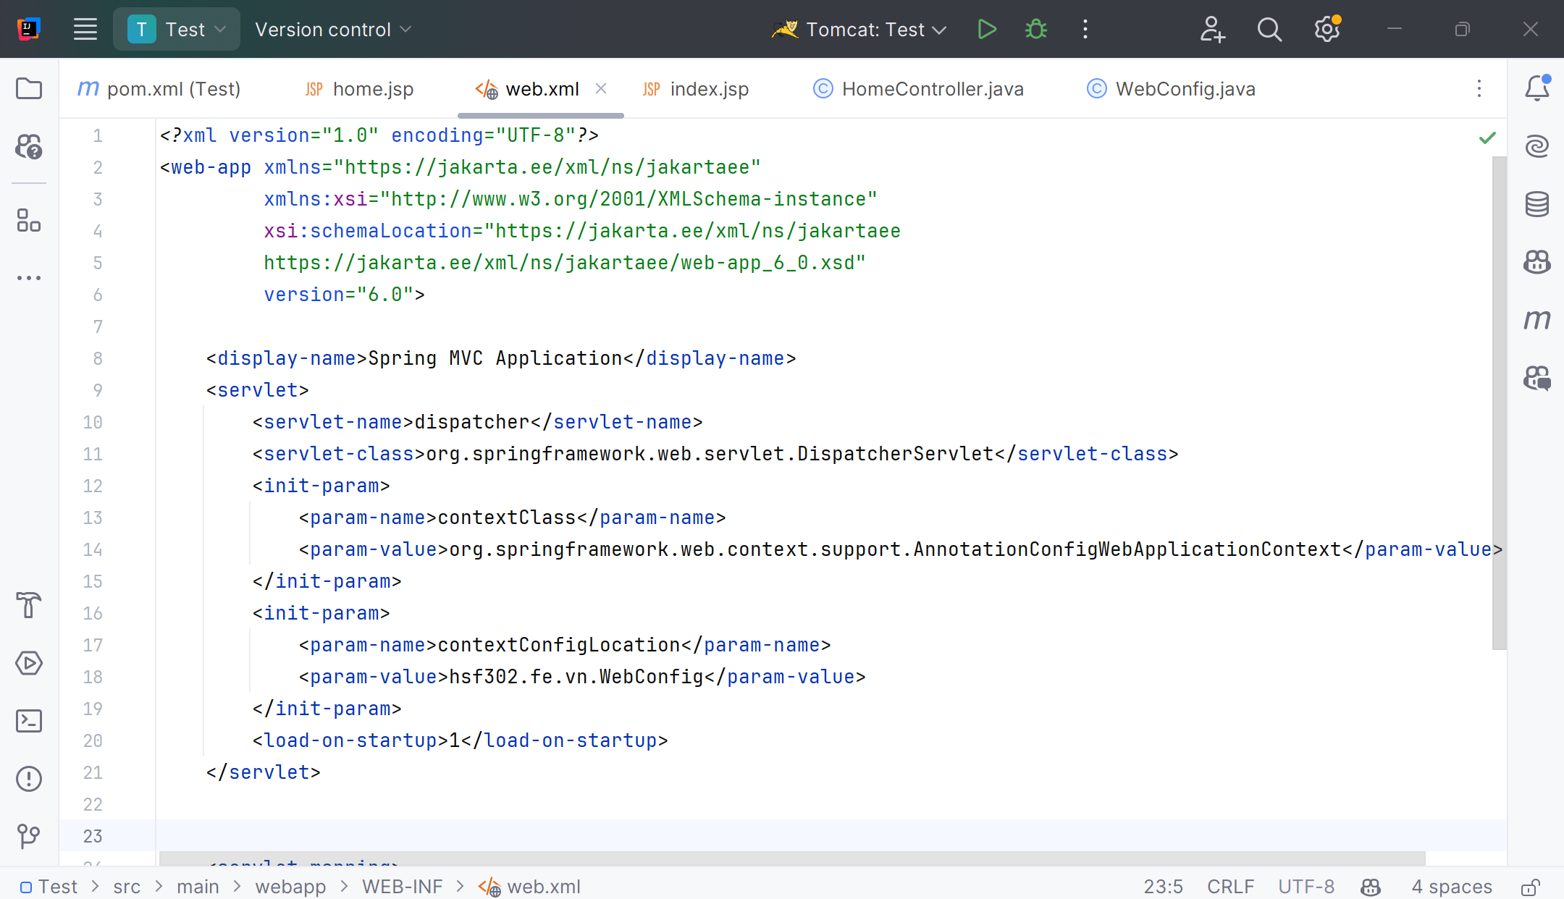
Configure DispatcherServlet in web.xml
Spring application will automatically be searched for and loaded by Spring for us.

Slide 17
Overriding DispatcherServlet defaults
Following 2 basic ones:
InternalResourceViewResolver (for jsp, css, images etc)
ContentNegotiatingViewResolver (for ContentType response, useful for REST APIs)
If the Controller returns “index”, InternalResourceViewResolver tries to find file as view /WEB-INF/views/index.jsp

Slide 18
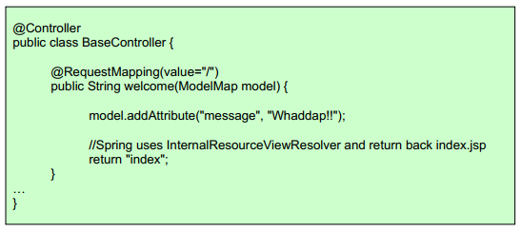
Controllers
The Controllers are central components of MVC
Simply add @Controller annotation to a class
Use @RequestMapping to map methods to url

Slide 19
Controllers
Controller Annotation
The @Controller annotation defines the class as a Spring MVC controller.
The @RequestMapping annotation is used to map URLs like '/hello' onto an entire class or a particular handler method.
@RequestMapping(method = RequestMethod.GET) is used to declare the printHello() method as the controller's default service method to handle HTTP GET request.

Slide 20
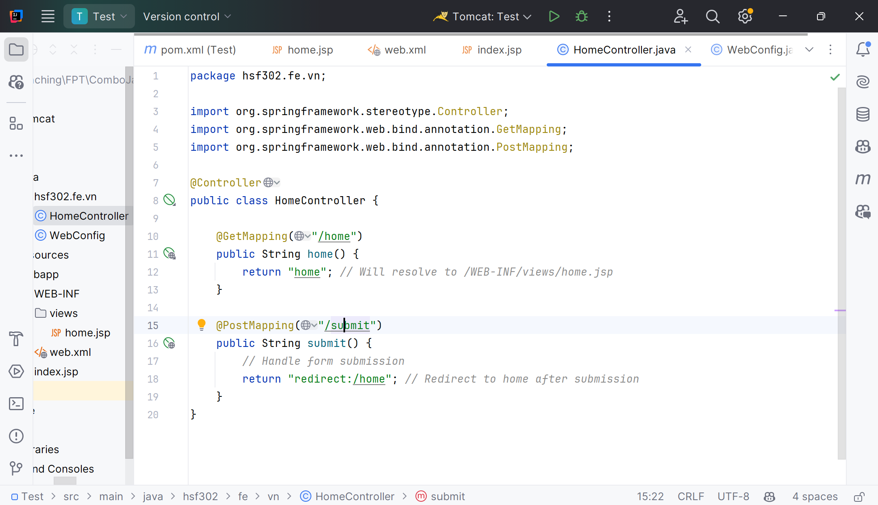
Example

Slide 21
Controller arguments
@RequestParam, @PathVariable
BindingResult – to access the results of binding and validation (POJO – arbitrary java object that gets populated with request values @Valid – to enforce validation of the POJO)
Model, ModelMap, Map<String, ?> access to the model object
Raw HttpServletRequest, HttpServletRespone, HttpSession
@RequestHeader, @RequestBody

Slide 22
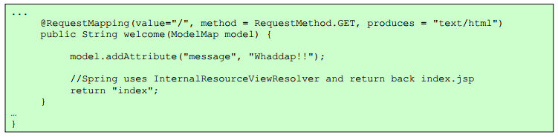
More detailed Url Mapping
@RequestMapping also accepts the following parameters:
method (GET/POST/PUT/DELETE...)
produces (mimeType)
consumes (mimeType)
params
headers

Slide 23
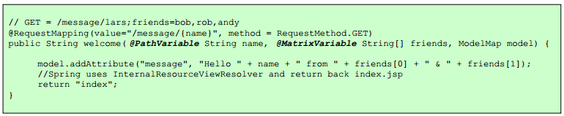
Url Templates in Controllers
@PathVariable - to map variables in URL paths
path variables can also be Regular Expressions
Can also do as follows /message/*/user/{name}
Can also use comma-separated URL parameters (also called Matrix-Variables)
To do this, make setRemoveSemicolonContent=false for RequestMappingHandlerMapping

Slide 24
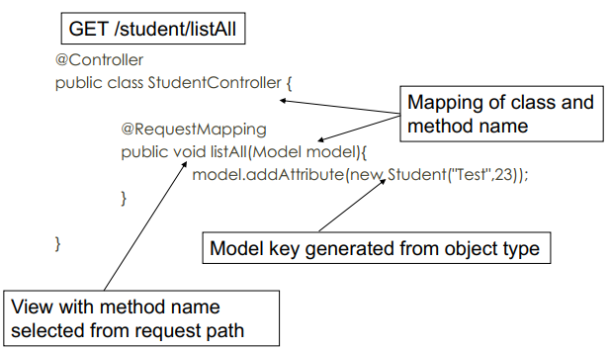
Convention over Configuration

Slide 25
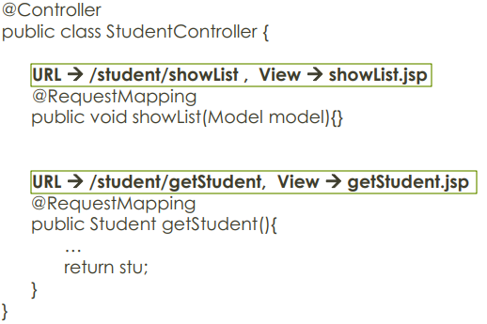
Convention over Configuration
Mapping By Convention

Slide 26
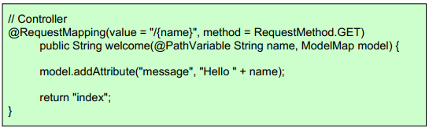
Model
Controllers and view share a Java object referred as model, (‘M’ in MVC)
A model can be of the type Model or can be a Map that can represent the model.
The view uses this to display dynamic data that has been given by the controller
In View:
<html> body><h1>${message}</h1></body> </html>

Slide 27
ModelAndView object in Spring MVC
ModelAndView is an object that holds both the model and view. The handler returns the ModelAndView object and DispatcherServlet resolves the view using View Resolvers and View.
The View is an object which contains view name in the form of the String and model is a map to add multiple objects.
ModelAndView model = new ModelAndView("employeeDetails");
model.addObject("employeeObj", new EmployeeBean(123));
model.addObject("msg", "Employee information.");
return model;

Slide 28
@ModelAttribute from Controller
You can also use @ModelAttribute in controller to directly load URL value into the model
A Model can represent objects that can be retrieved from database or files as well
Model should not have logic, rather the controller should get the model and “transform” the model based on the request, while sending it to the View

Slide 29
View
Spring MVC integrates with many view technologies:
JSP
Thymeleaf
Velocity
Freemarker
JasperReports
Values sent to controller with POST or GET as usual
Values made available to the view by the controller

Slide 30
Spring’s form tag library
Binding-aware JSP tags for handling form elements
Integrated with Spring MVC to give the tags access to the model object and reference data
Comes from spring-webmvc.jar
Add the following to make the tags available:
<%@ taglib prefix="form" uri="http://www.springframework.org/tags/form" %>

Slide 31
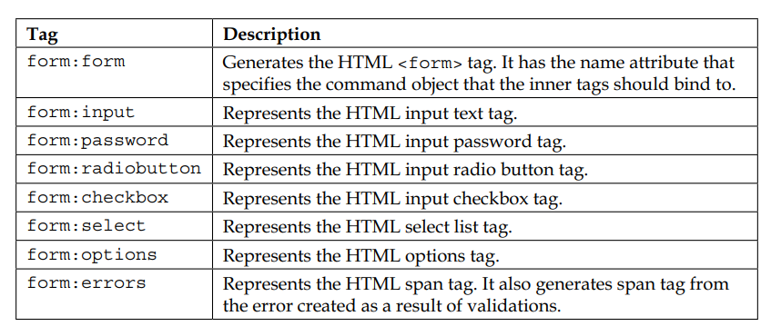
Spring’s form tag library

Slide 32
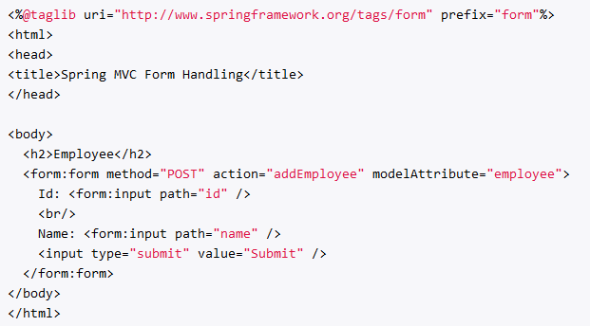
The attributes: path & modelAttribute/commandName
commandName/modelAttribute: name of a variable in the request scope or session scope that contaims the information about this form, it should be a been.
path: name of a bean property that should be accessed in order to pass the information to from and to the controller.

Slide 33
The form tag
Renders a form tag and exposes the binding to inner tags
You can specify any HTML attributes that are valid for an HTML form
You can also tell it what the form backing object is (it uses ‘command’ by default).
@RequestMapping("/person/add")
public String addPerson(Model model) {
Person person = new Person();
model.addAttribute(person);
return "addPerson";
}
<form:form method=”get” commandName=”person”>
<form:input path=”name” />
</form:form>
<form method=”get”>
<input type=”text” name=”name” />
</form>

Slide 34
The input tag
Renders an HTML input tag with a type of ‘text’
You can specify any HTML attributes valid for an HTML input
You bind it to your model object by specifying the path relative to the backing object
@RequestMapping("/person/add")
public String addPerson(Model model) {
Person person = new Person();
person.setName(”Spencer”);
model.addAttribute(person);
return "addPerson";
}
<form:form method=”get” commandName=”person”>
<form:input path=”name” />
</form:form>
<form method=”get”>
<input type=”text” name=”name” value=”Spencer” />
</form>

Slide 35
The checkbox tag
Renders an HTML input tag with a type of ‘checkbox’
public class Person {
private boolean admin;
private String[] languages;
}
<form:form commandName=”person”>
<form:checkbox path=”admin” />
<form:checkbox path=“languages” value=“Java” />
<form:checkbox path=“languages” value=“Scala” />
</form:form>
<form>
<input type=”checkbox” name=”admin” value=”true” />
<input type=”checkbox” name=”languages” value=”Java” />
<input type=”checkbox” name=”languages” value=”Scala” />
</form>

Slide 36
The checkboxes tag
Similar to checkbox tag, but creates multiple checkboxes instead of one
public class Person {
private boolean admin;
private String[] favoriteLanguages;
private List<String> allLanguages;
}
<form:form commandName=”person”>
<form:checkbox path=”admin” />
<form:checkboxes path=”favoriteLanguages” items=”${allLanguages}” />
</form:form>
<form>
<input type=”checkbox” name=”admin” value=”true” />
<input type=”checkbox” name=” favoriteLanguages” value=”Java” />
<input type=”checkbox” name=” favoriteLanguages” value=”Scala” />
</form>

Slide 37
The password tag
Renders an HTML input tag with a type of ‘password’
<form:form>
<form:input path=”username” />
<form:password path=”password” />
</form:form>
<form>
<input type=”text” name=”username” />
<input type=”password” name=”password” />
</form>

Slide 38
The select tag
Renders an HTML select tag
It can figure out whether multiple selections should be allowed
You can bind options using this tag, as well as by nesting option and options tags
<form:select path=”favoriteLanguage” items=”${allLanguages}” />
<select name=”favoriteLanguage”>
<option value=”Java”>Java</option>
<option value=”Scala”>Scala</option>
</form>

Slide 39
The option/options tags
Renders an HTML option (or multiple options)
Nested within a select tag
Renders ‘selected’ based on the value bound to the select tag
<form:select path=”favoriteLanguage”>
<form:option value=”3” label=”.NET” />
<form:options items=”${languages}” itemValue=”id” itemLabel=”name” />
</form:select>
<select name=”favoriteLanguage”>
<option value=”.NET”>.NET</option>
<option value=”Java”>Java</option>
<option value=”Scala”>Scala</option>
</form>

Slide 40
The errors tag
Renders an HTML span tag, containing errors for given fields
You specify which fields to show errors for by specifying a path
path=“name” – Would display errors for name field.
path=“*” – Would display all errors
<form:errors path=”*” cssClass=”errorBox” />
<form:errors path=”name” cssClass=”specificErrorBox” />
<span name=”*.errors” class=”errorBox”>Name is required.</span>
<span name=“name.errors” class=“specificErrorBox”>Name is required.</span>

Slide 41
Spring Exception
@ExceptionHandler only handles exception getting raised from the controller where it is defined.
It will not handle exceptions getting raised from other controllers. @ControllerAdvice annotation solves this problem.
@ControllerAdvice annotation is used to define @ExceptionHandler,@InitBinder, and @ModelAttribute methods that apply to all @RequestMapping methods.

Slide 42
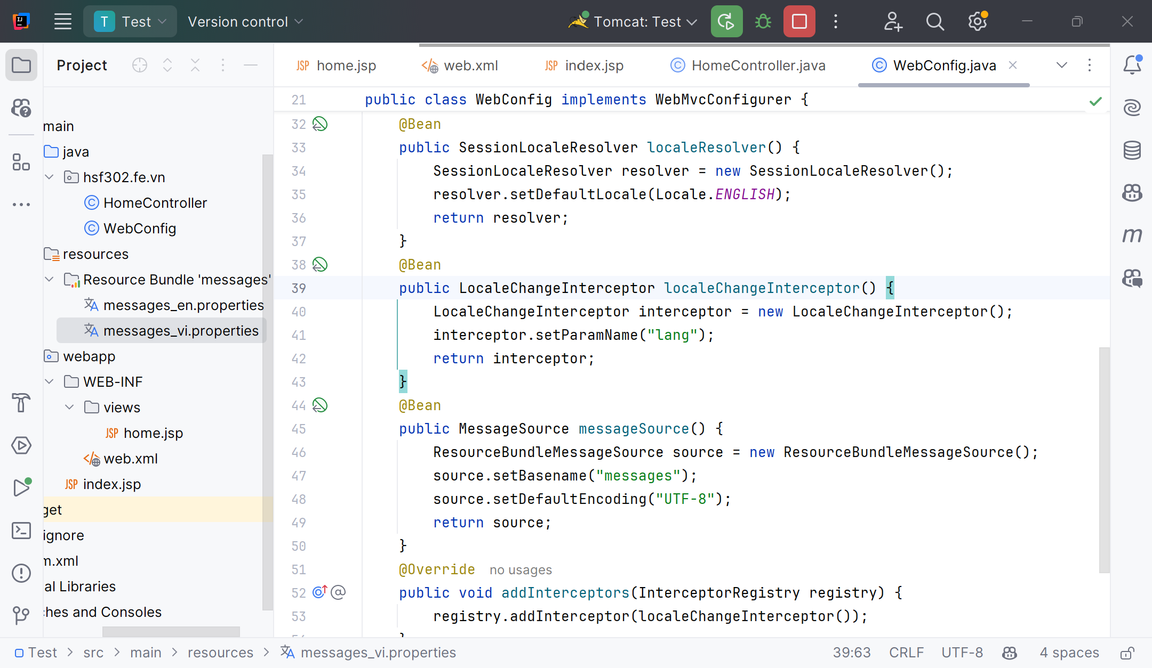
Locales

Slide 43
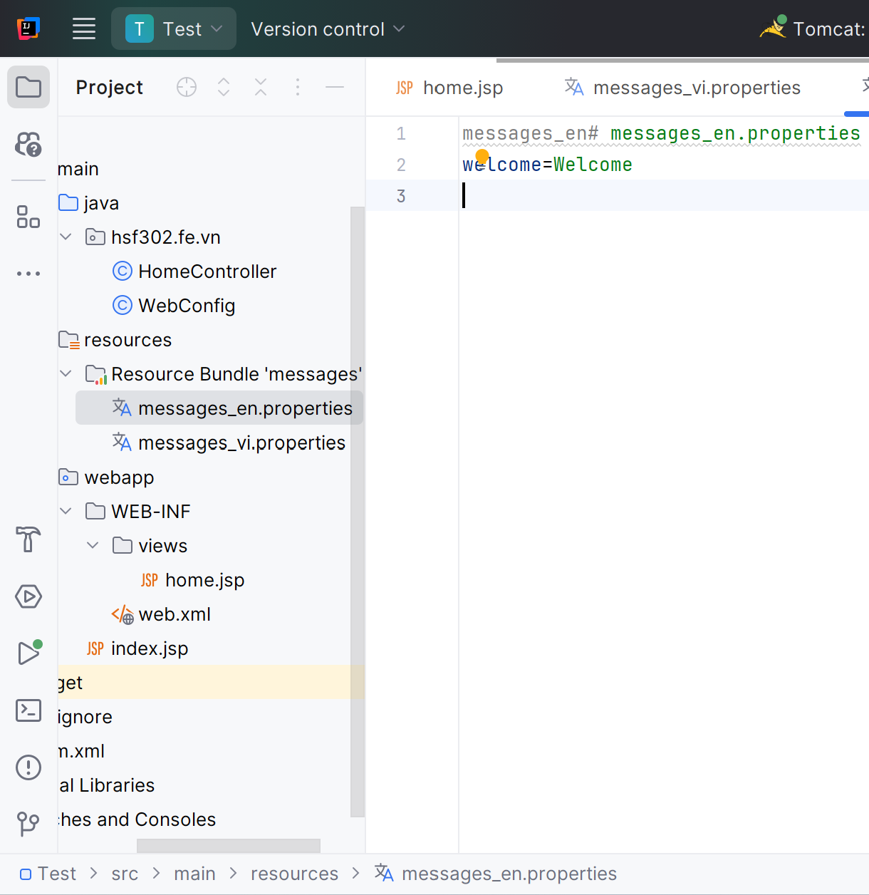
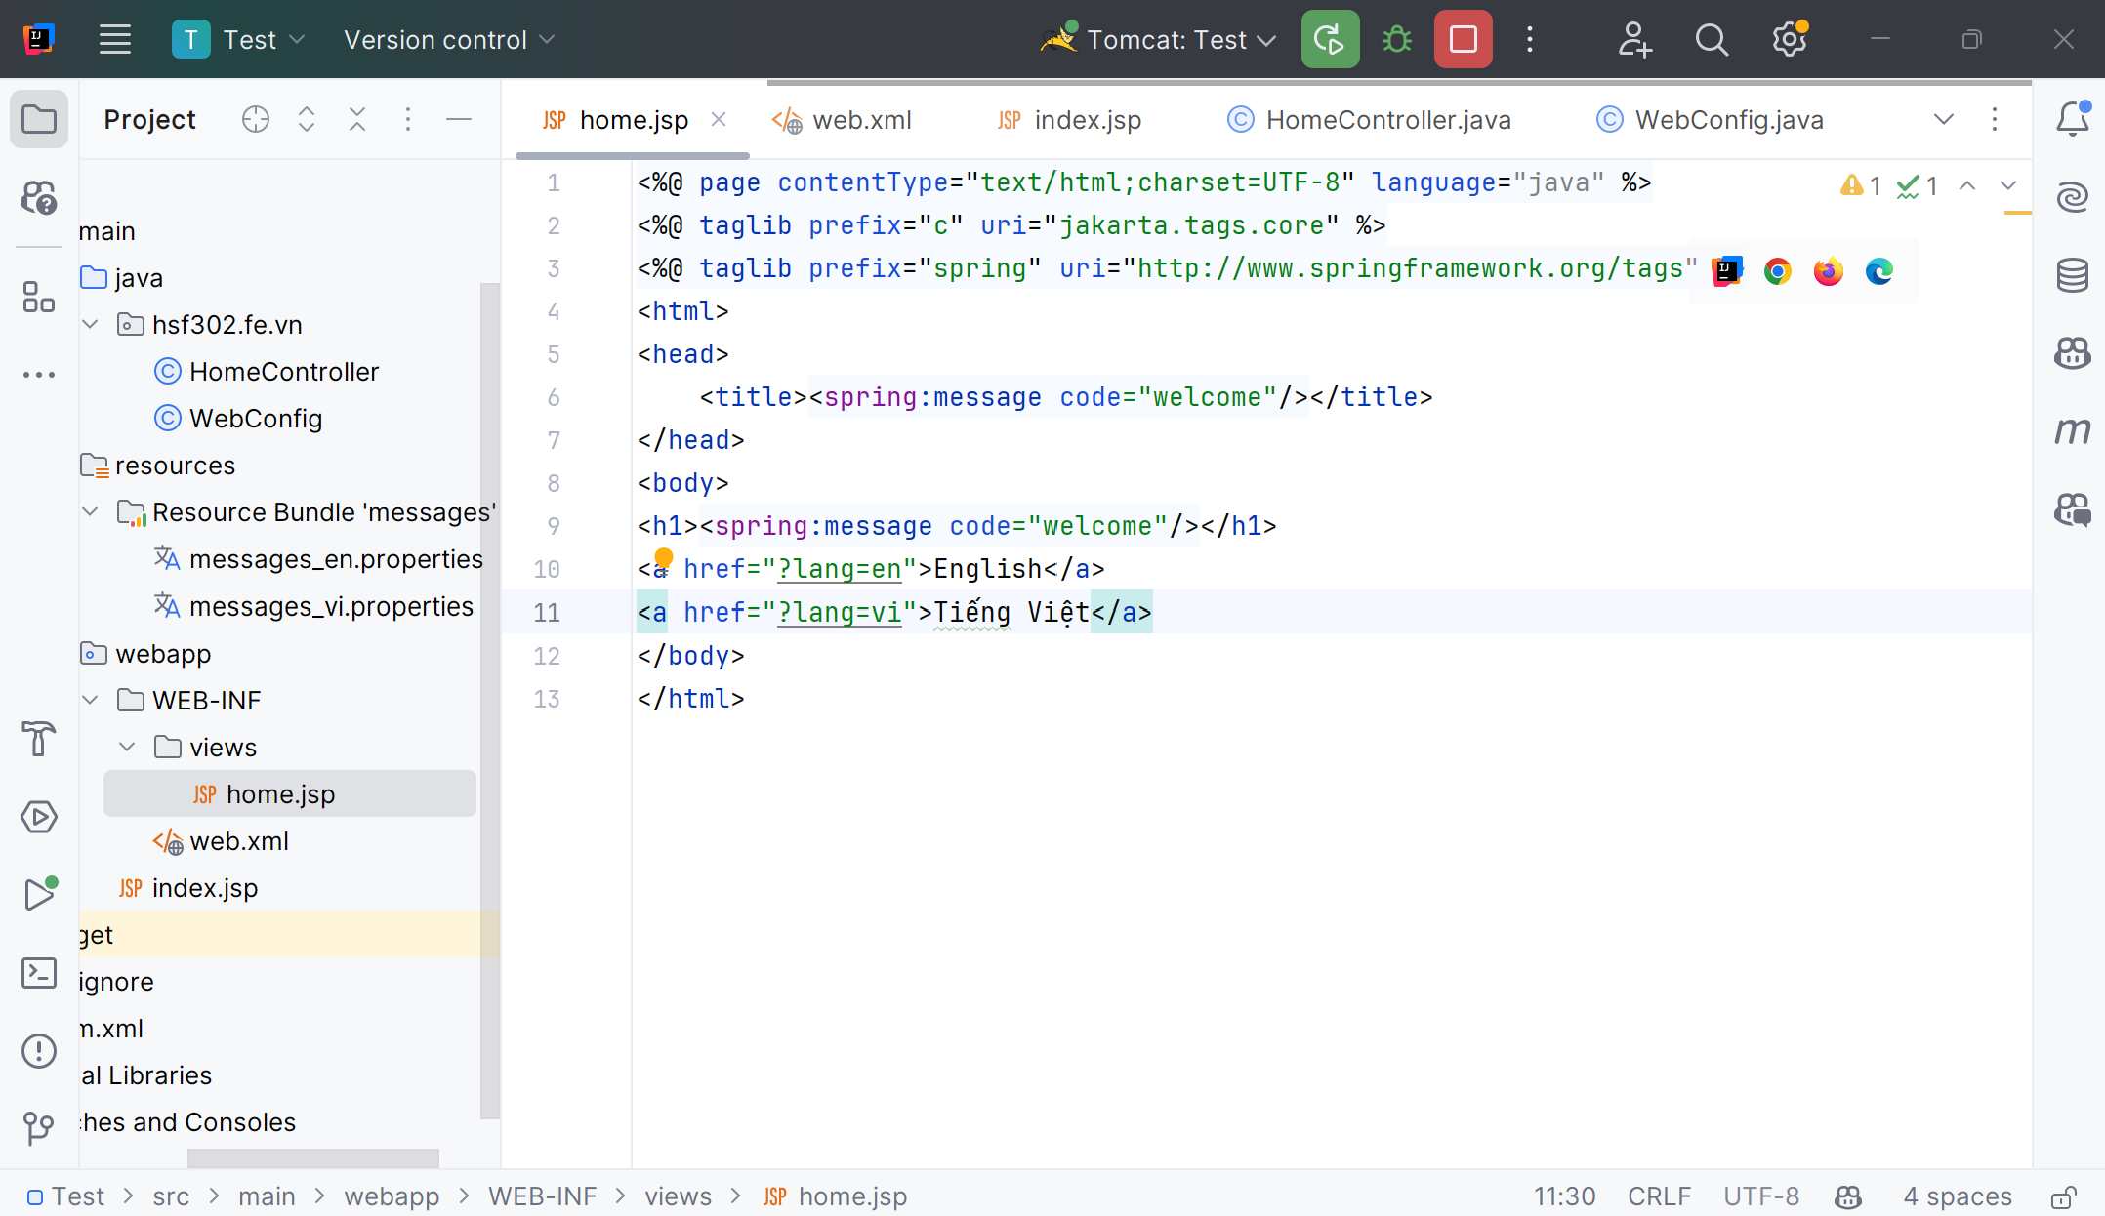
Locales

Slide 44
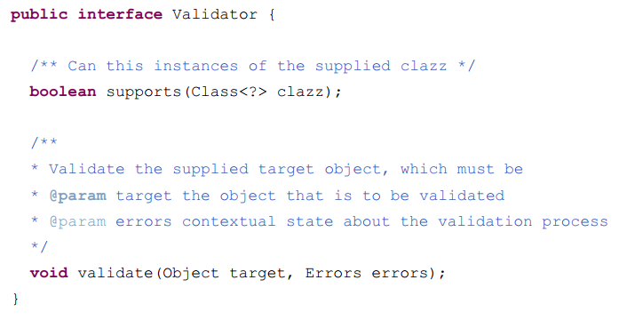
Spring Validation
Spring provides a simplified set of APIs and supporting classes for validating domain objects.
Spring features a Validator interface that you can use to validate objects. The Validator interface works using an Errors object so that while validating, validators can report validation failures to the Errors object.
Validation using Spring’s Validator interface

Slide 45
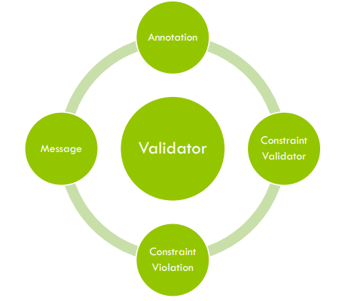
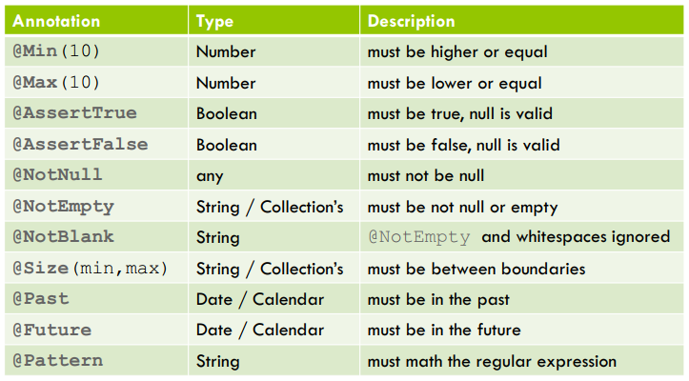
Spring Validation
Standard Constraints

Slide 46
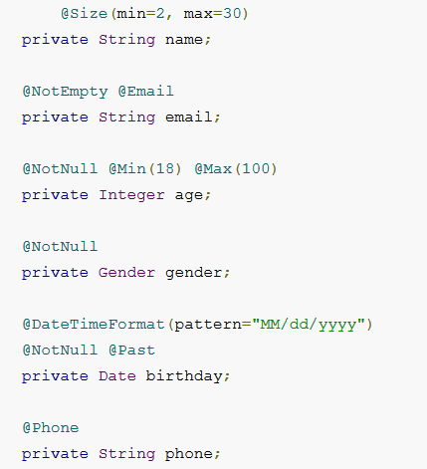
import javax.validation.constraints.Max;
import javax.validation.constraints.Min;
import javax.validation.constraints.NotNull;
import javax.validation.constraints.Past;
import javax.validation.constraints.Size;
import org.hibernate.validator.constraints.Email;
import org.hibernate.validator.constraints.NotEmpty;
import org.springframework.format.annotation.DateTimeFormat;
@Phone: defined custom validator.

Slide 47
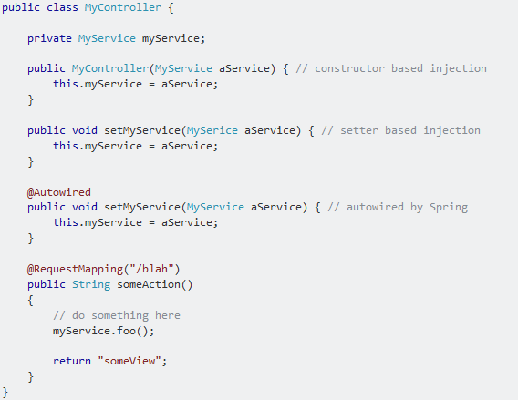
@Autowired
@Autowired on Setter Methods
@Autowired on Properties
@Autowired on Constructors
@Autowired on Constructors

Slide 48
Demo SpringMVC

Slide 49
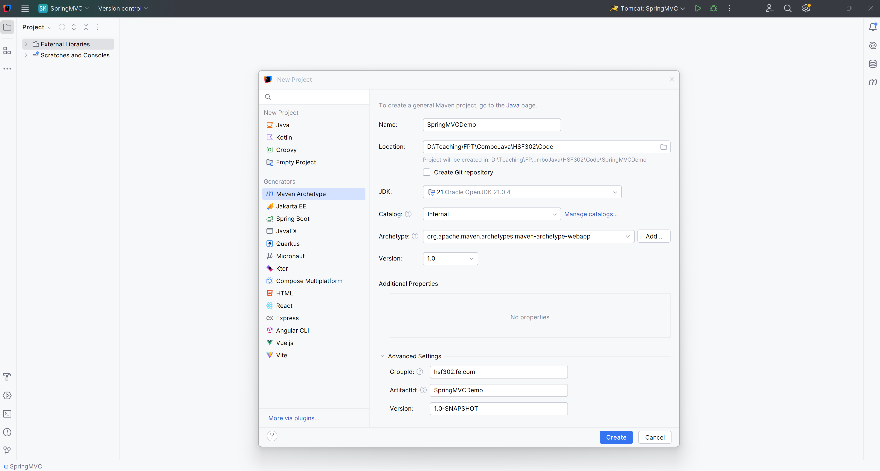
Open IntelliJ, File | New | Maven Project

Slide 50
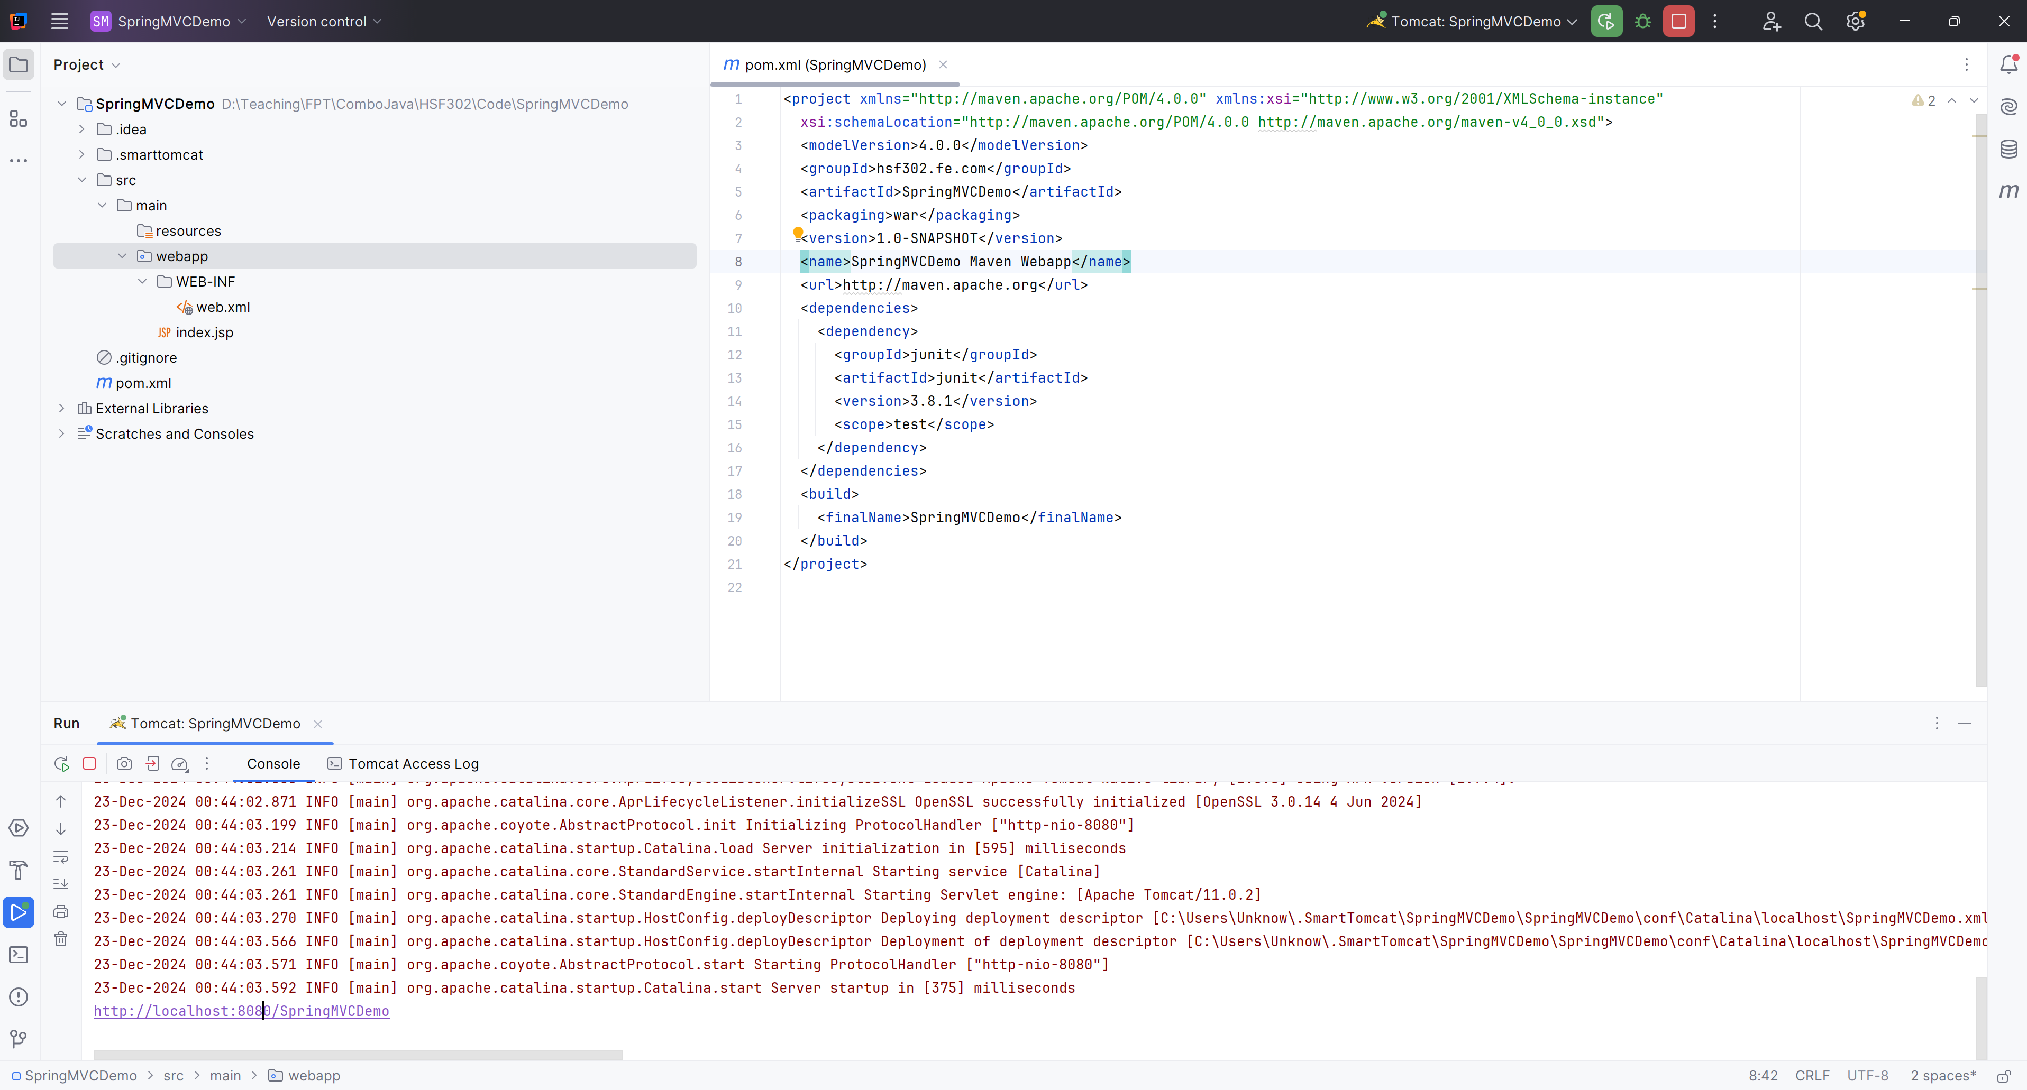
Run Project
1

Slide 51
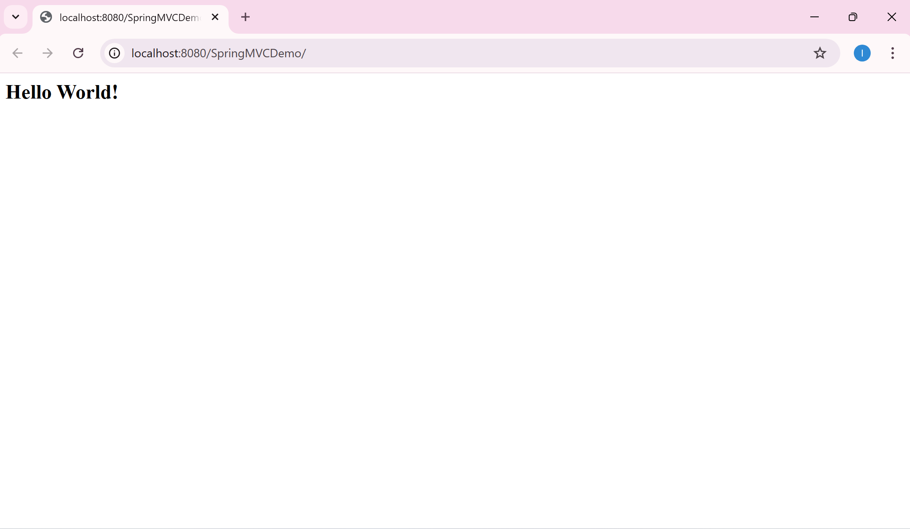
Result
1

Slide 52
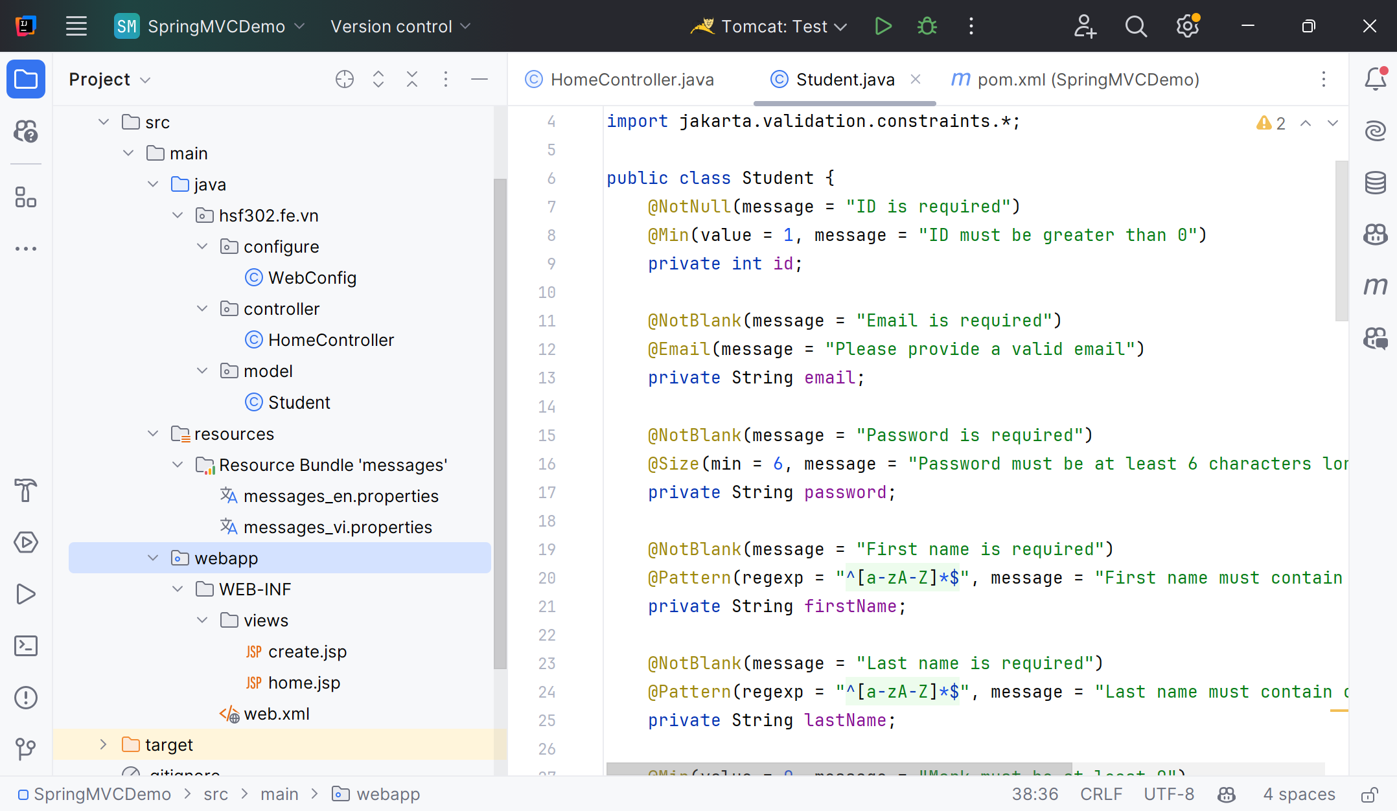
Create a structure of Maven Project

Slide 53
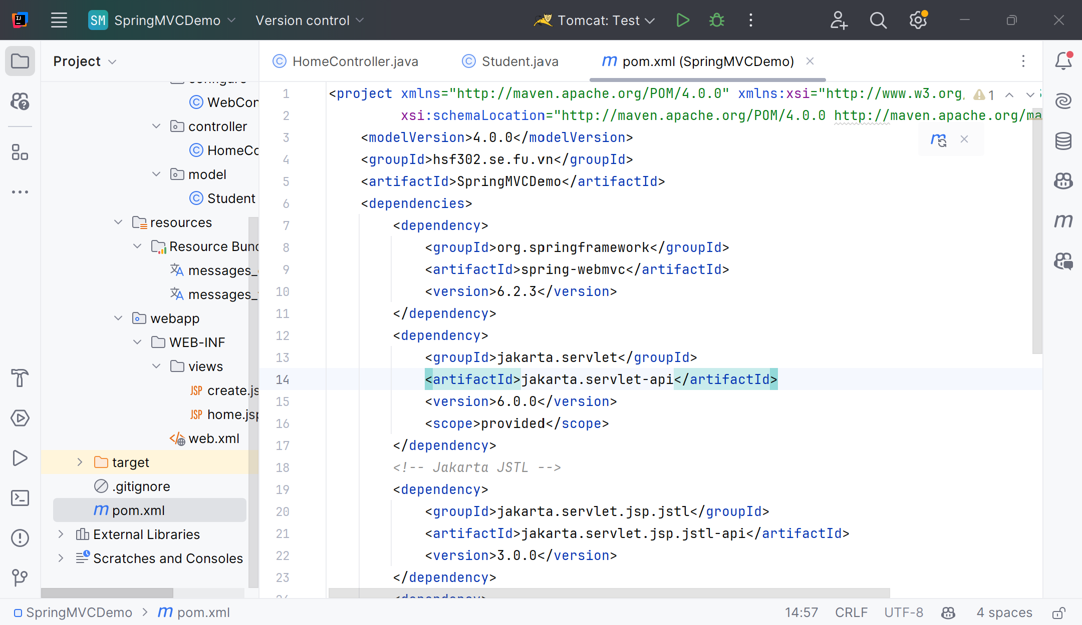
Edit pom.xml
1

Slide 54
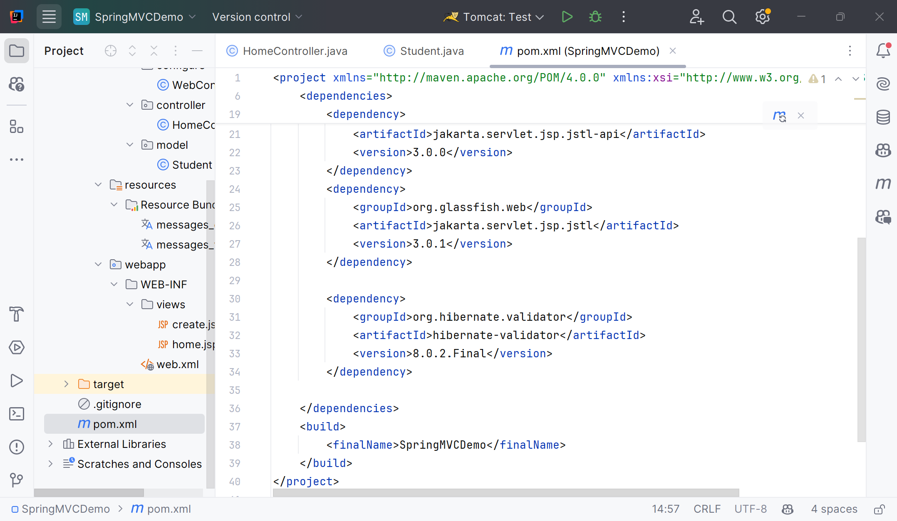
Edit pom.xml
1

Slide 55
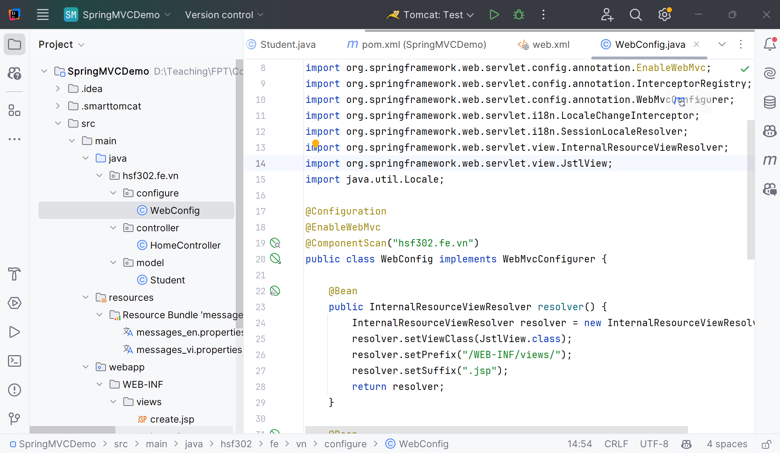
Create the WebConfig.java
1

Slide 56
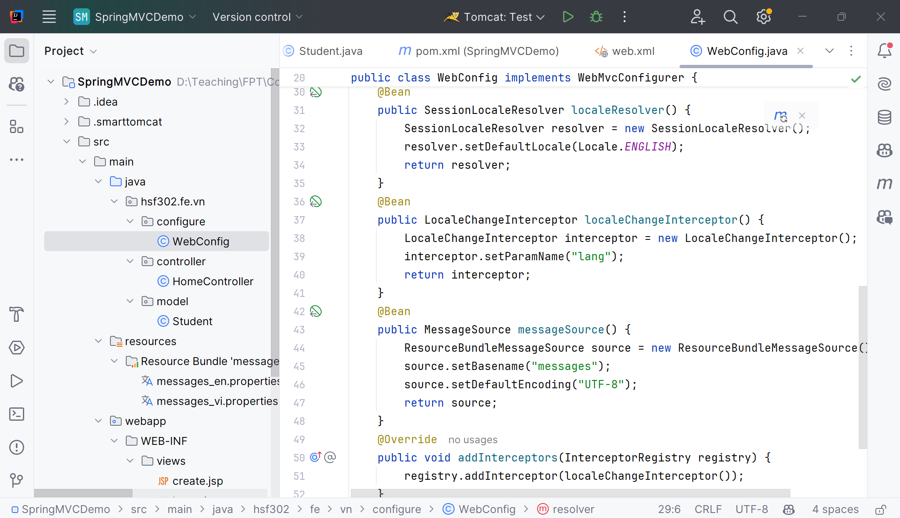
Edit the WebConfig.java
1

Slide 57
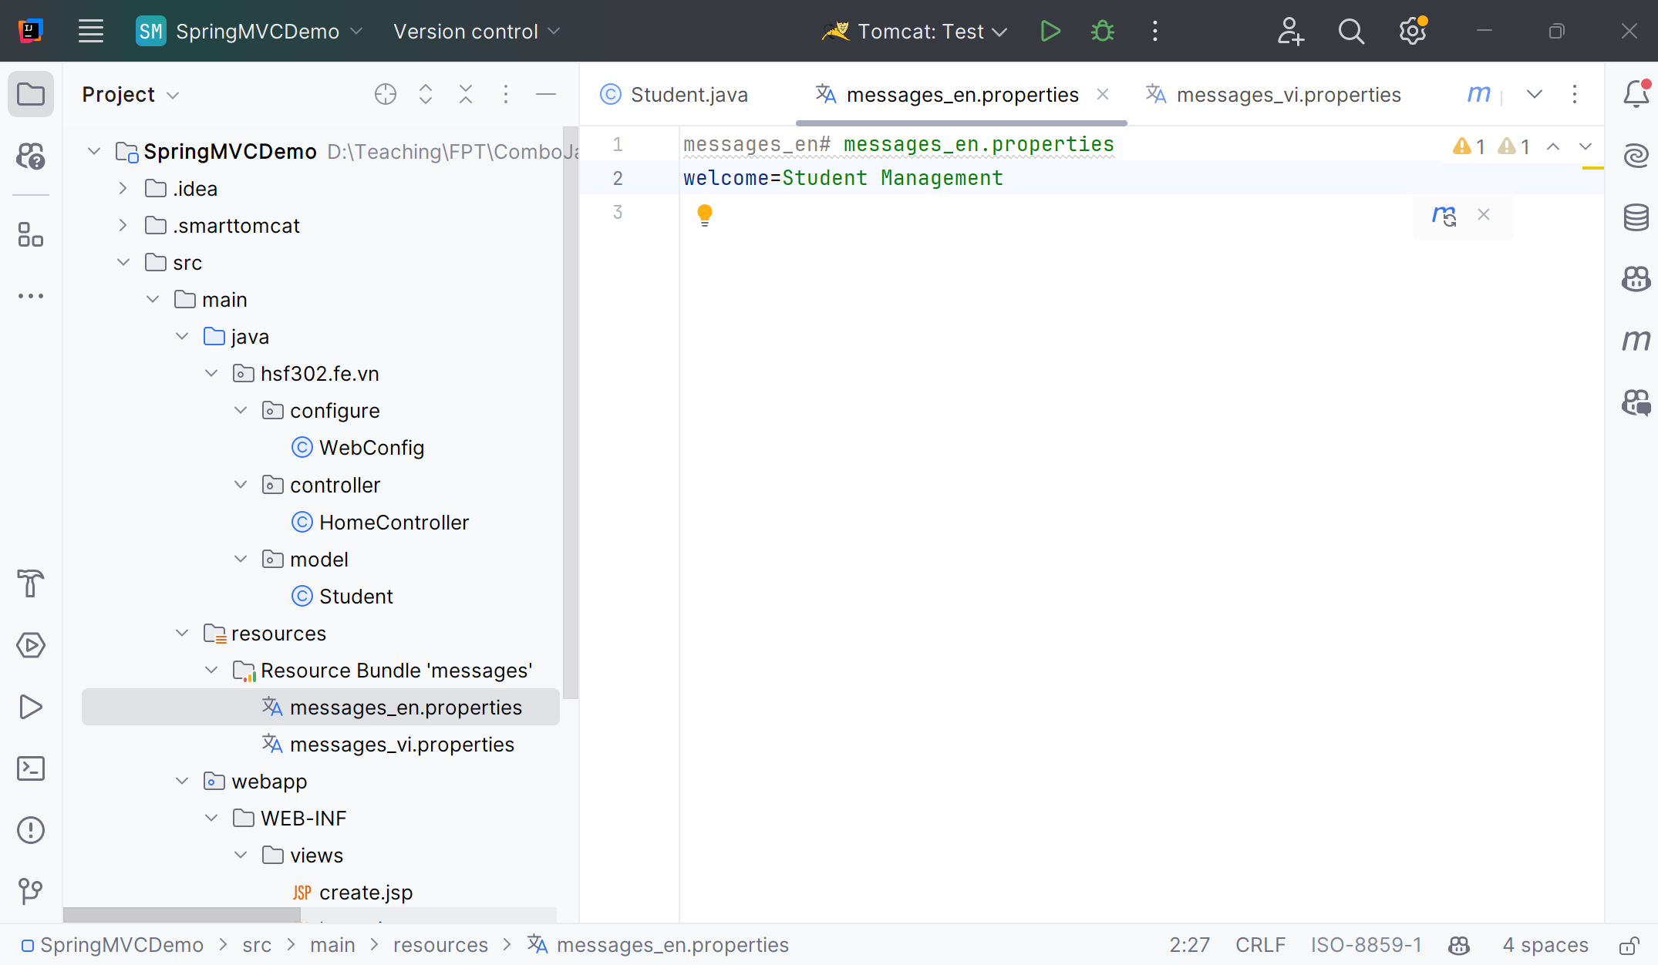
Create messages_en.properties and messages_vi.properties
1

Slide 58
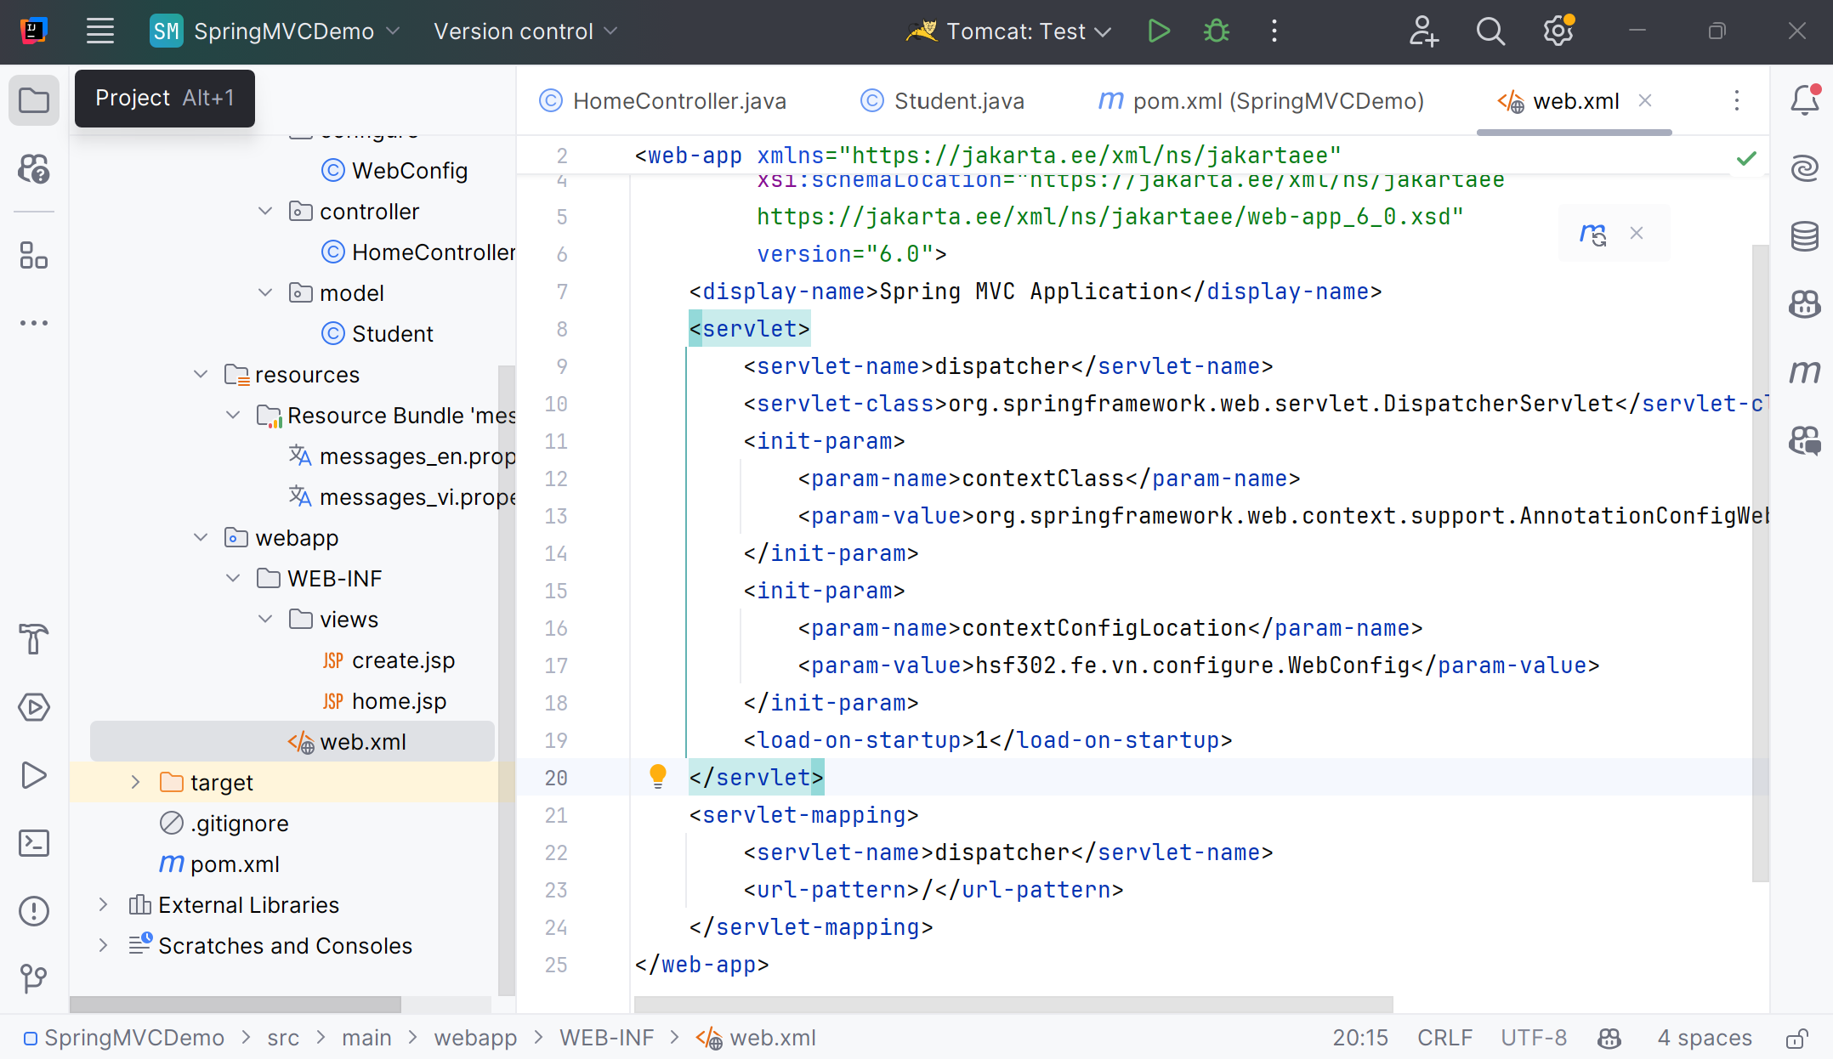
Edit web.xml
1

Slide 59
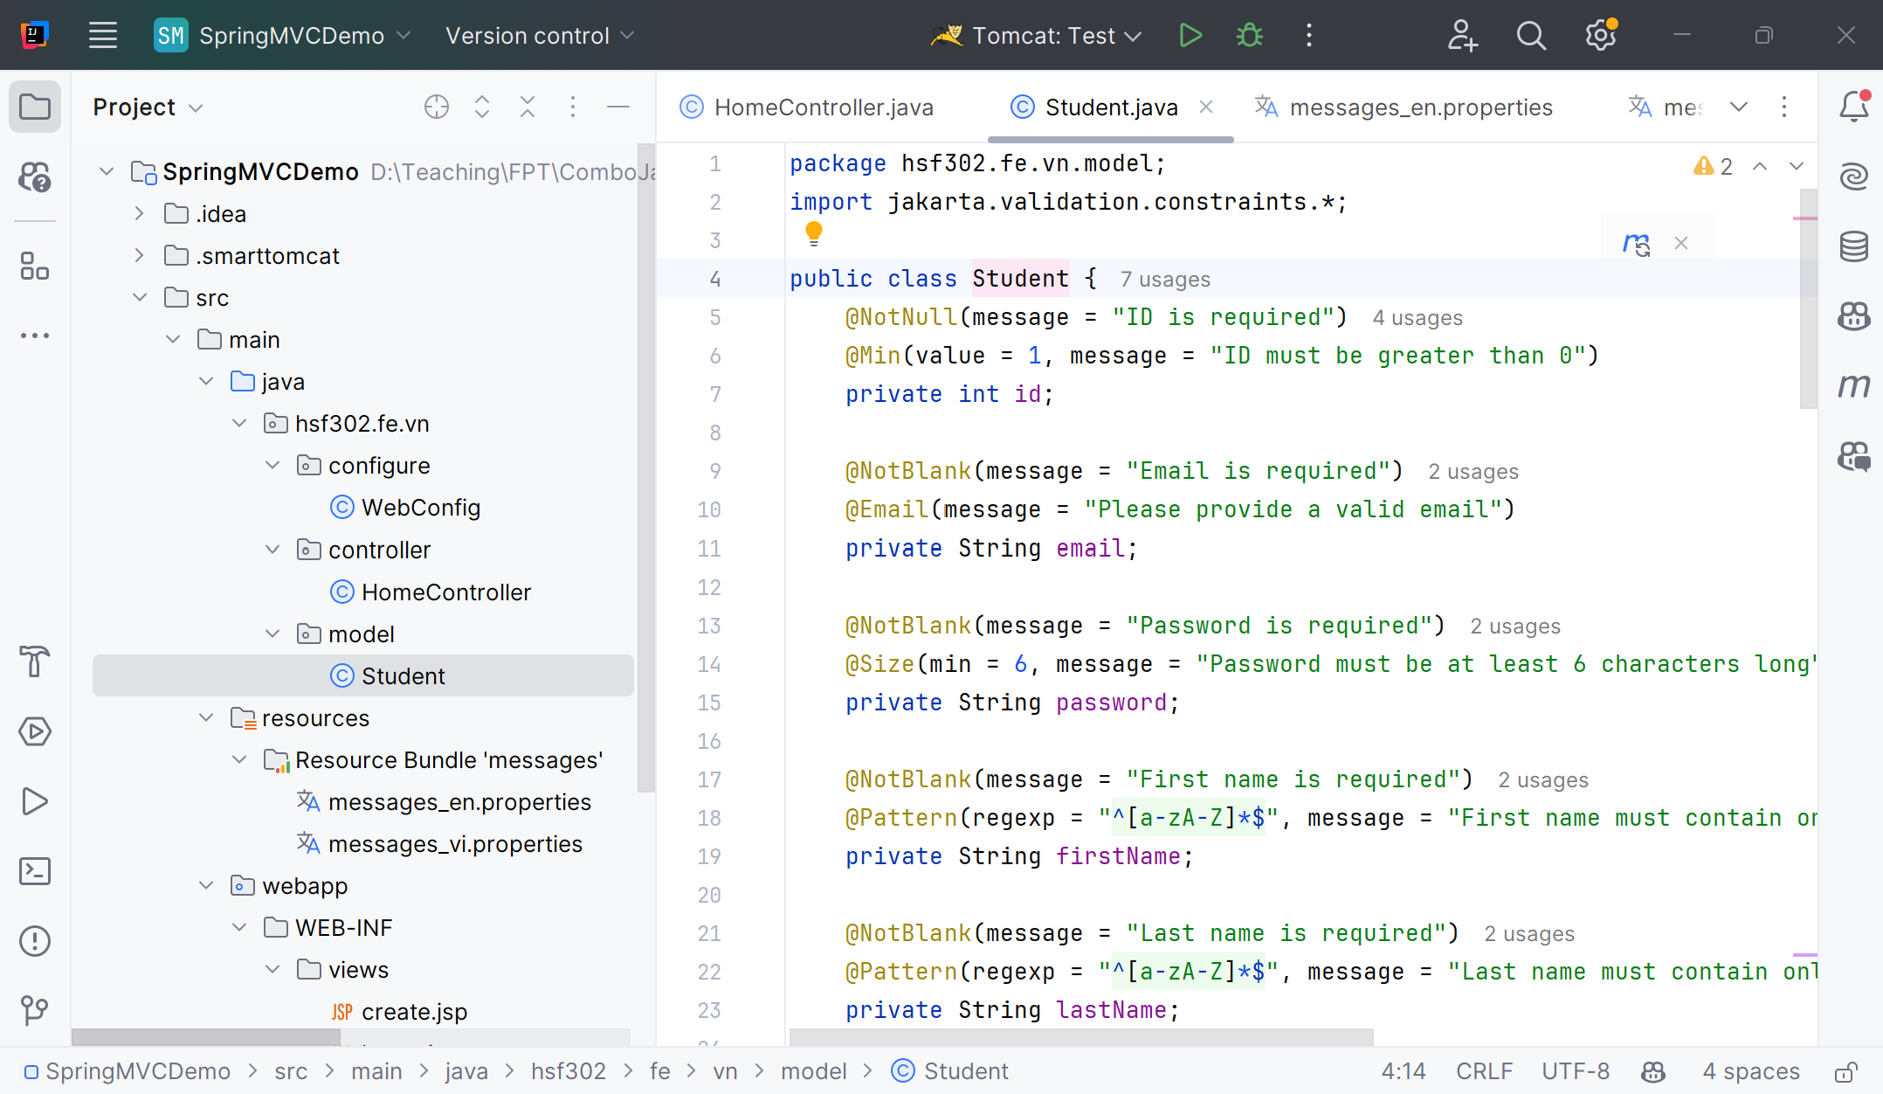
Create the Student.java
1

Slide 60
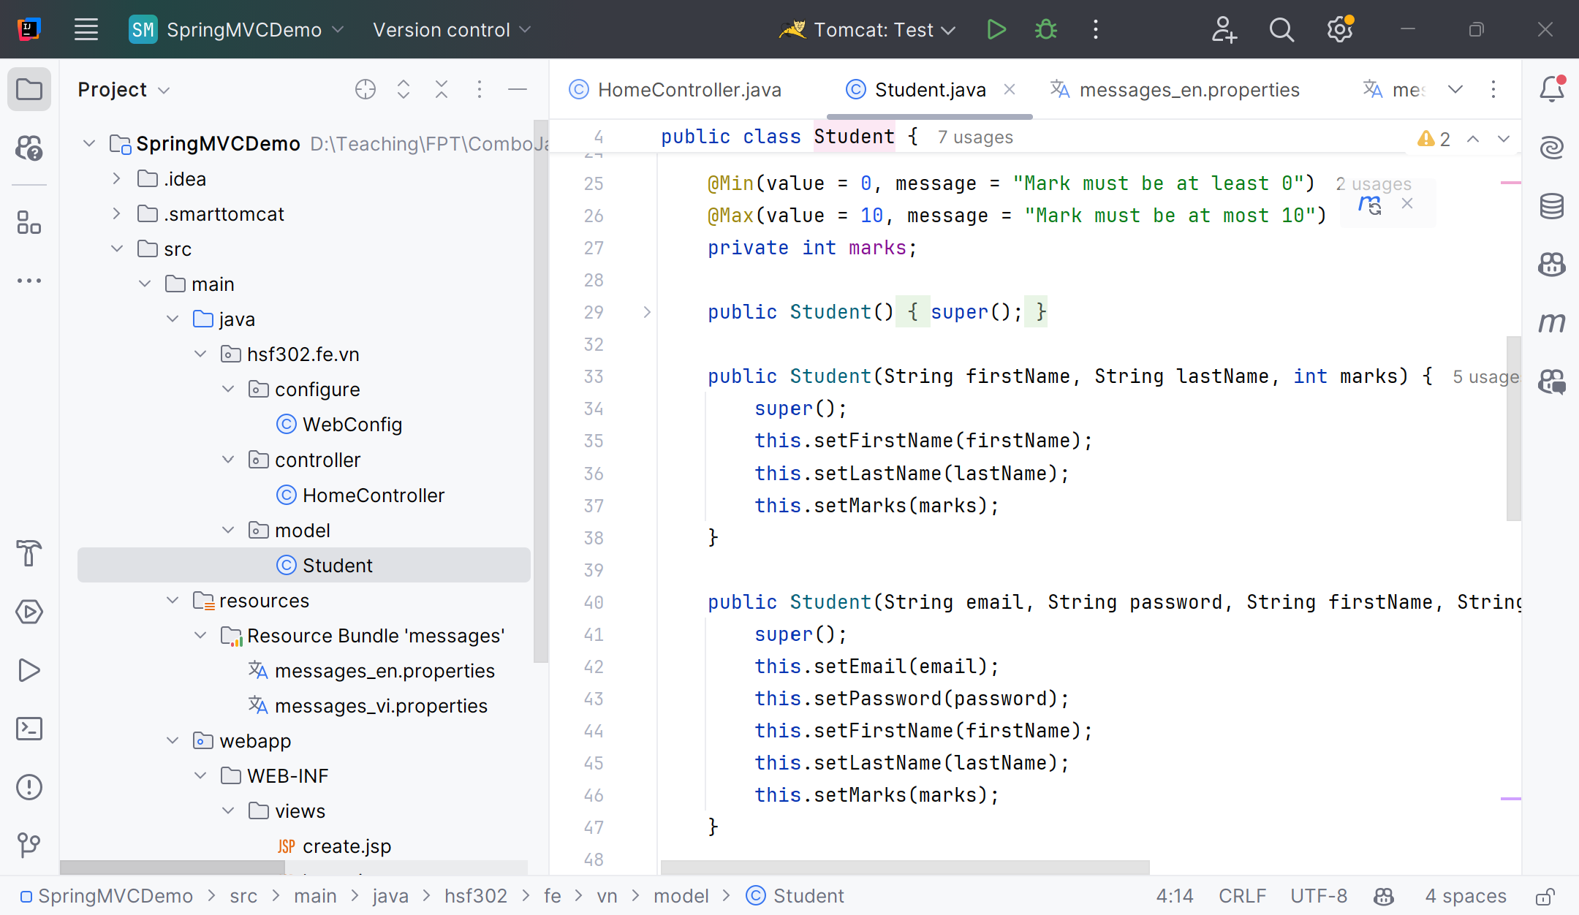
Edit the Student.java
1

Slide 61
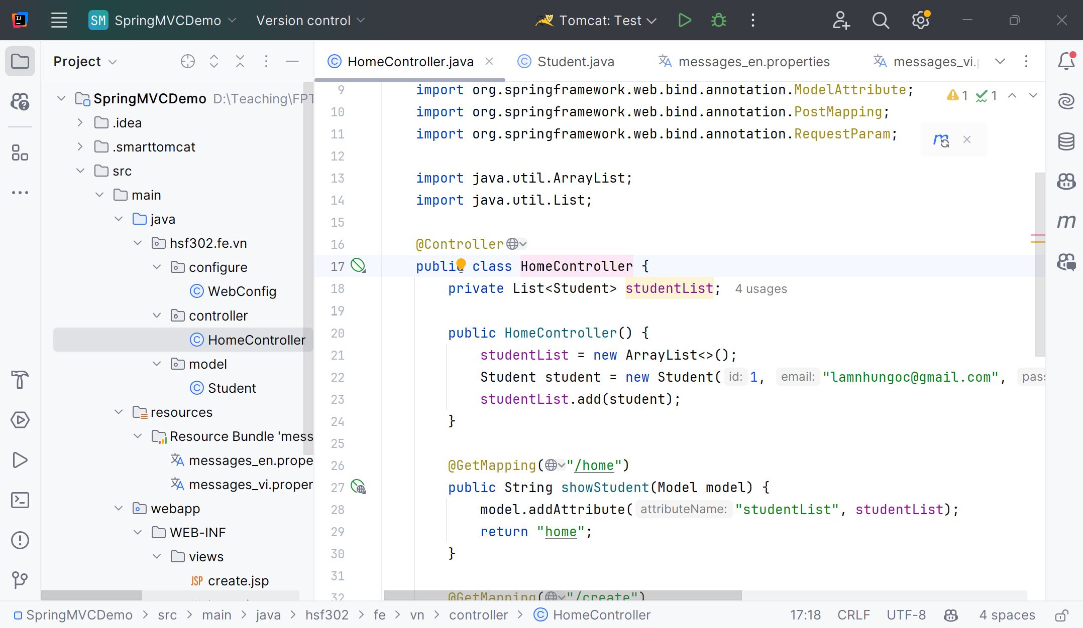
Create HomeController.java
1

Slide 62
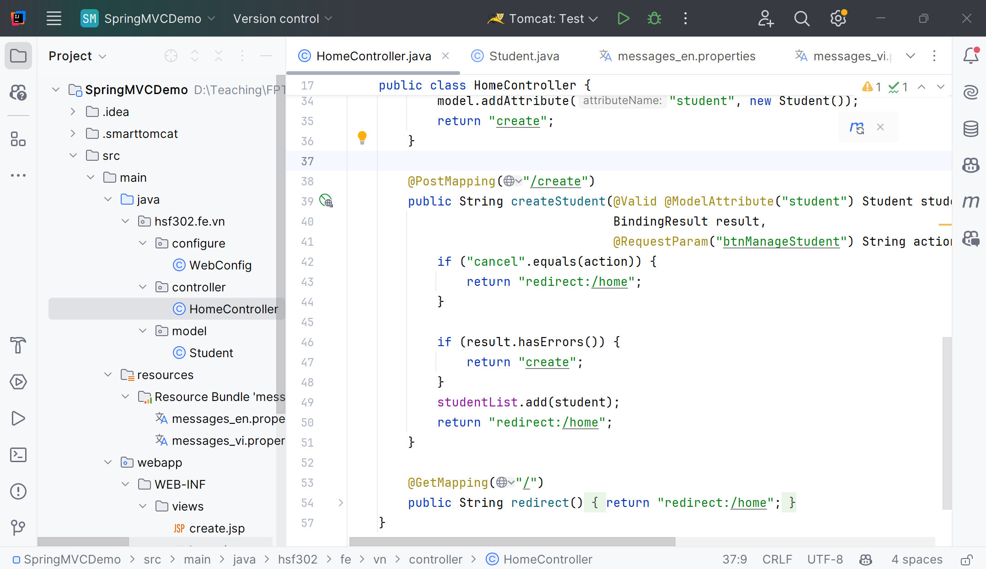
Edit HomeController.java
1

Slide 63
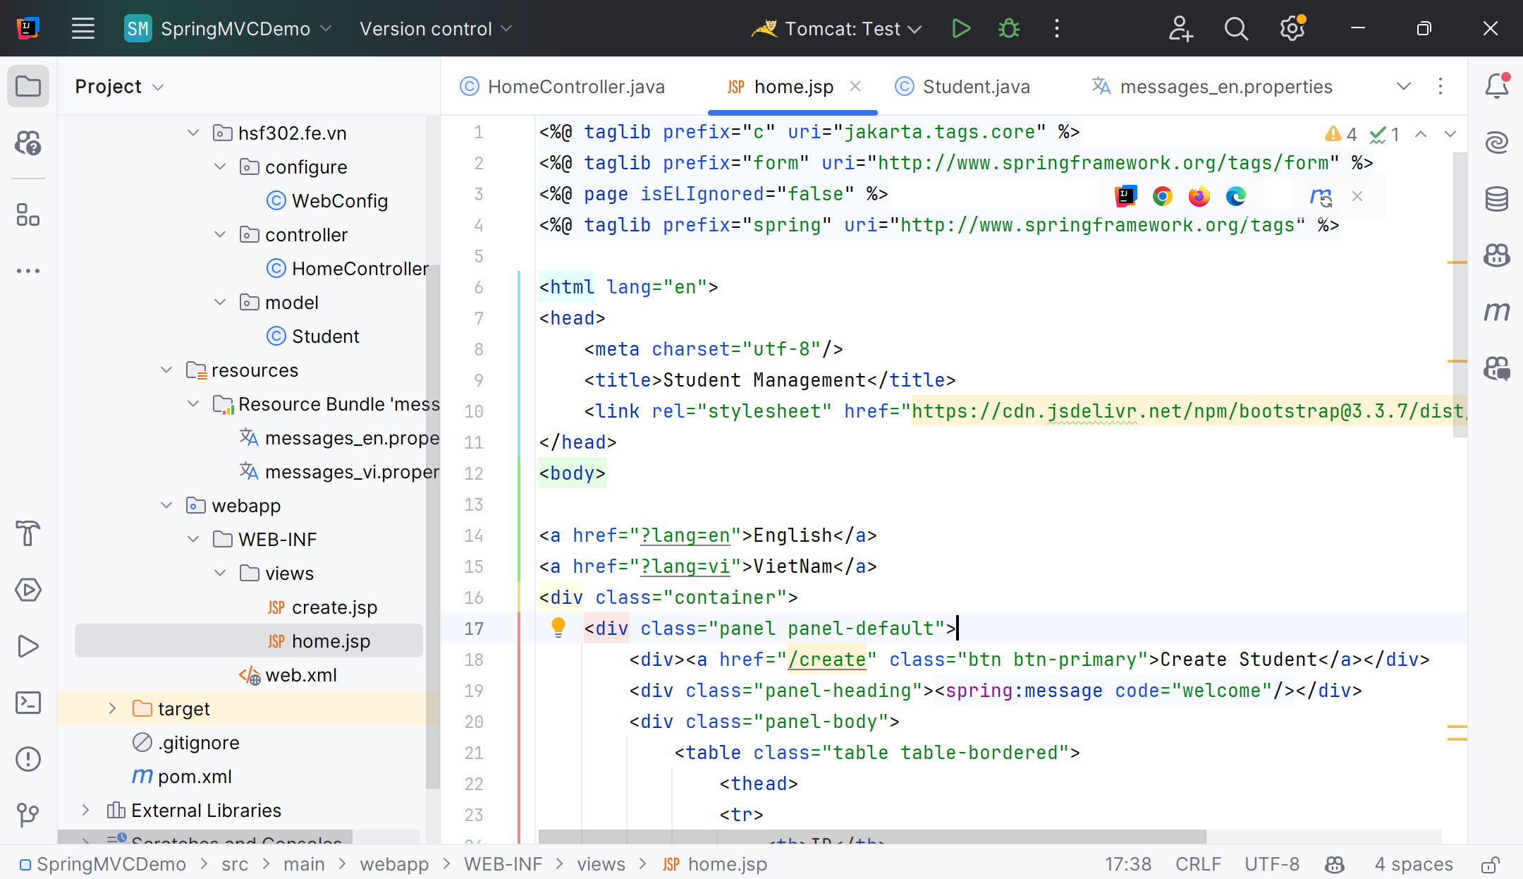
Create home.jsp
1

Slide 64
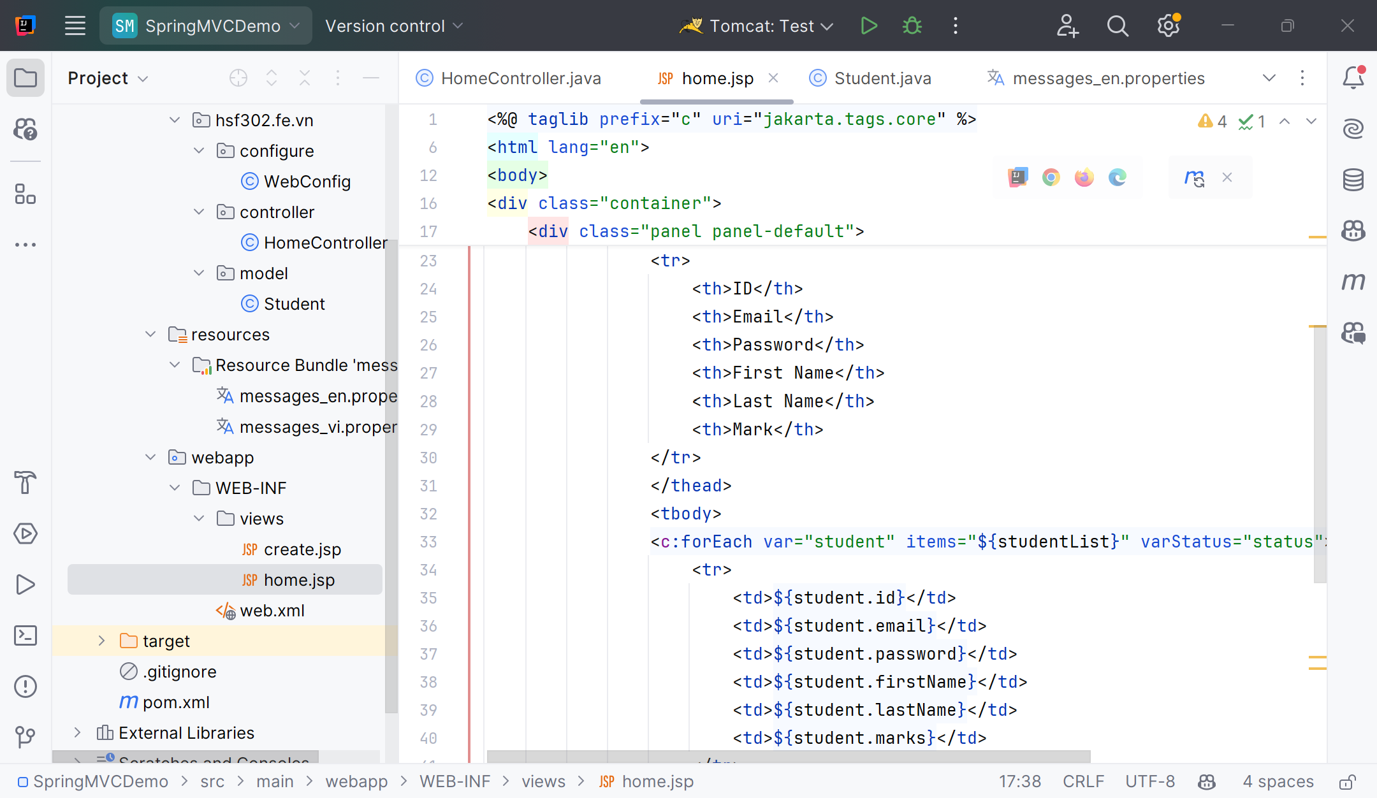
Edit home.jsp
1

Slide 65
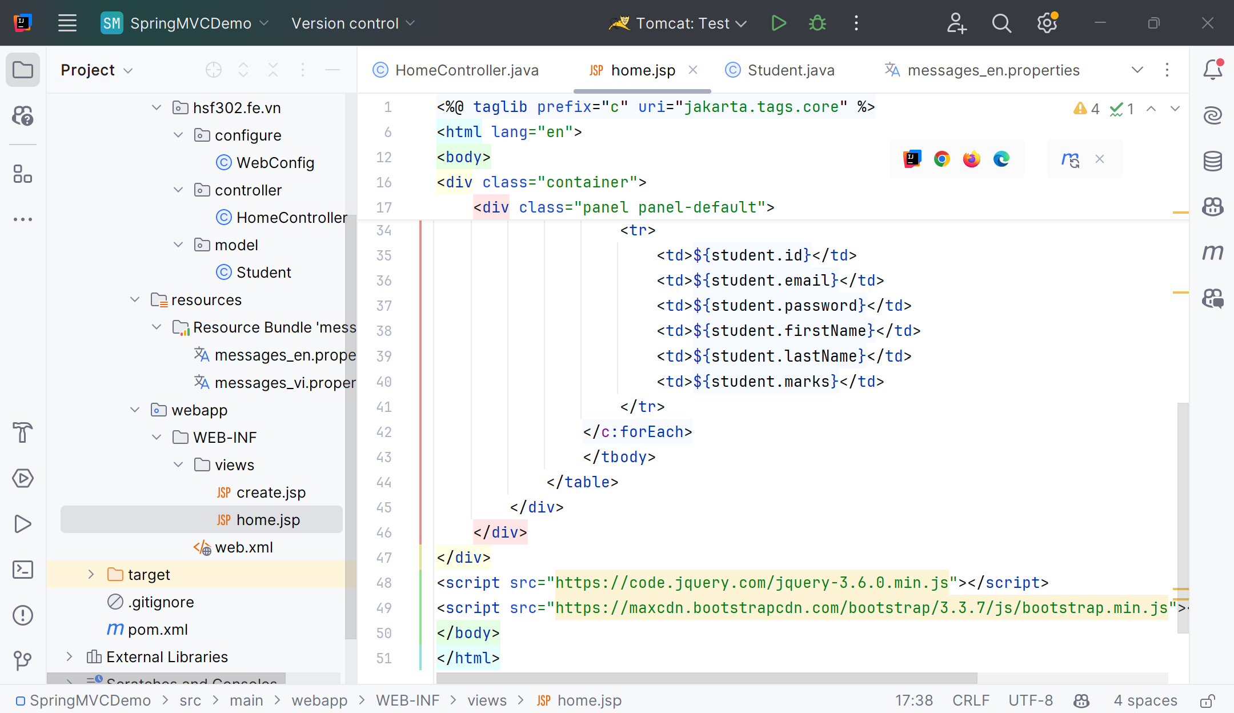
Edit home.jsp
1

Slide 66
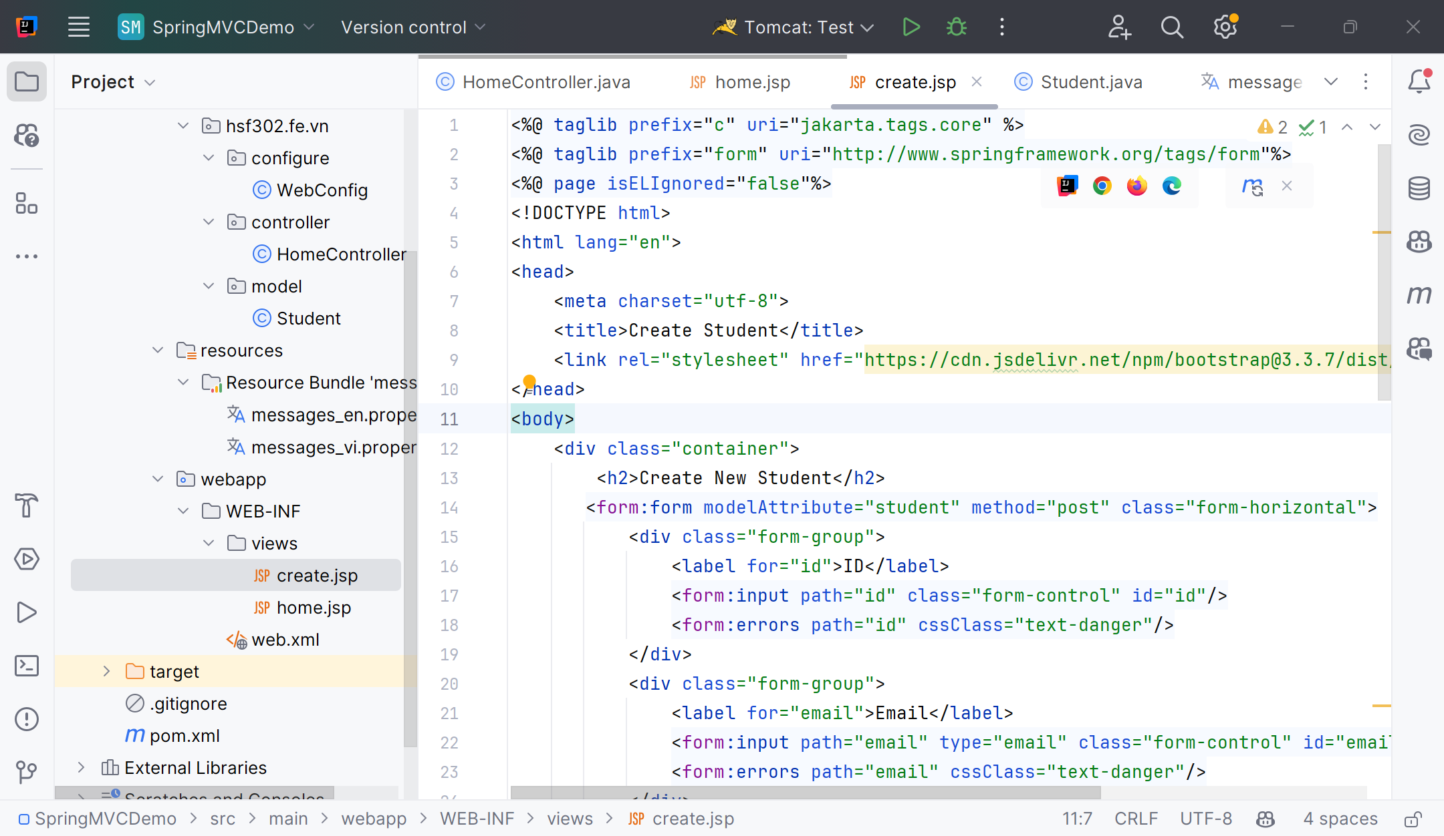
Create create.jsp
1

Slide 67
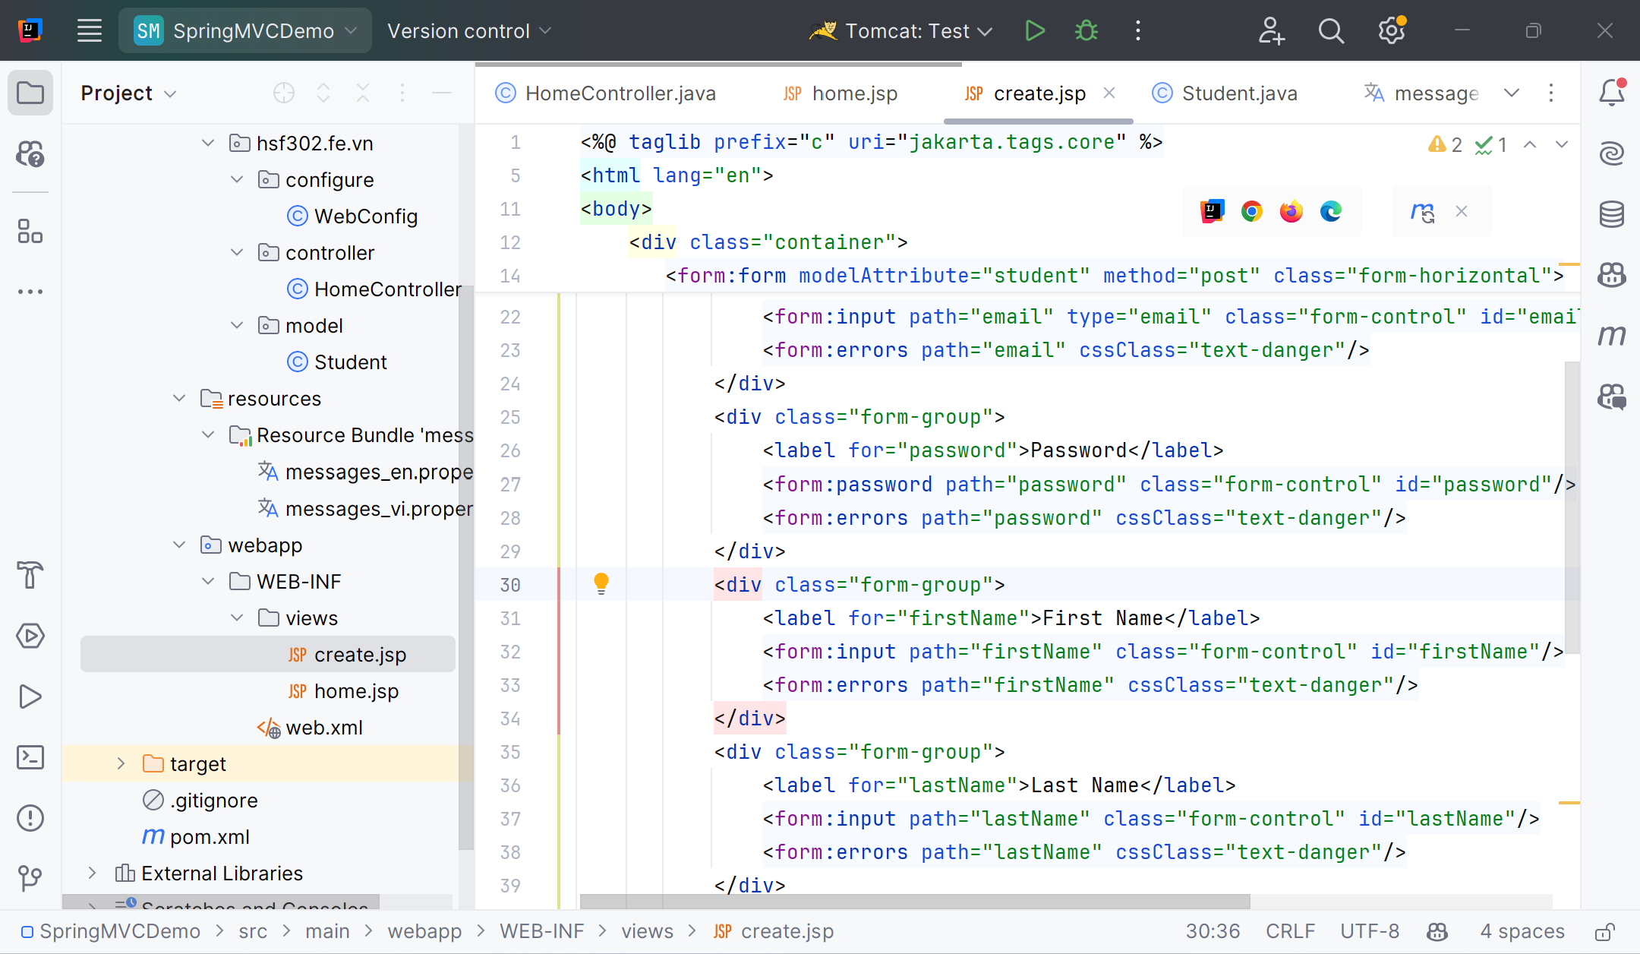
Edit create.jsp
1

Slide 68
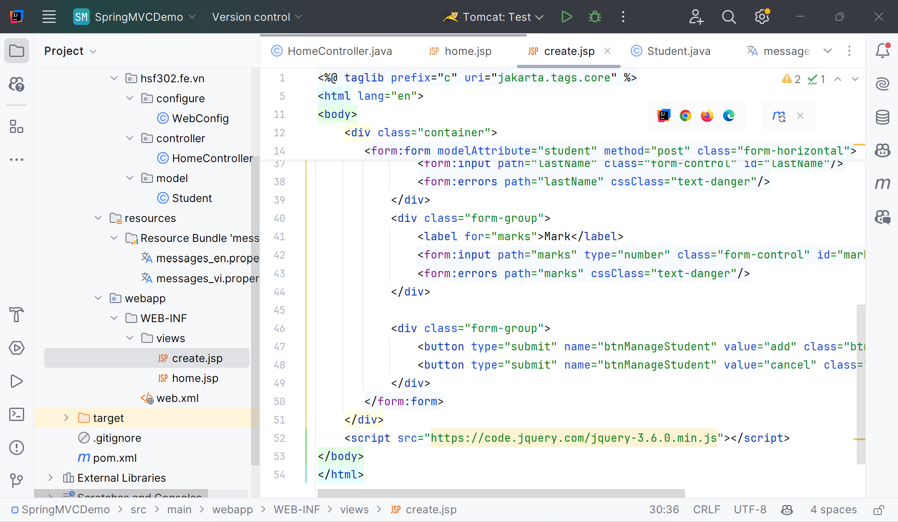
Edit create.jsp
1

Slide 69
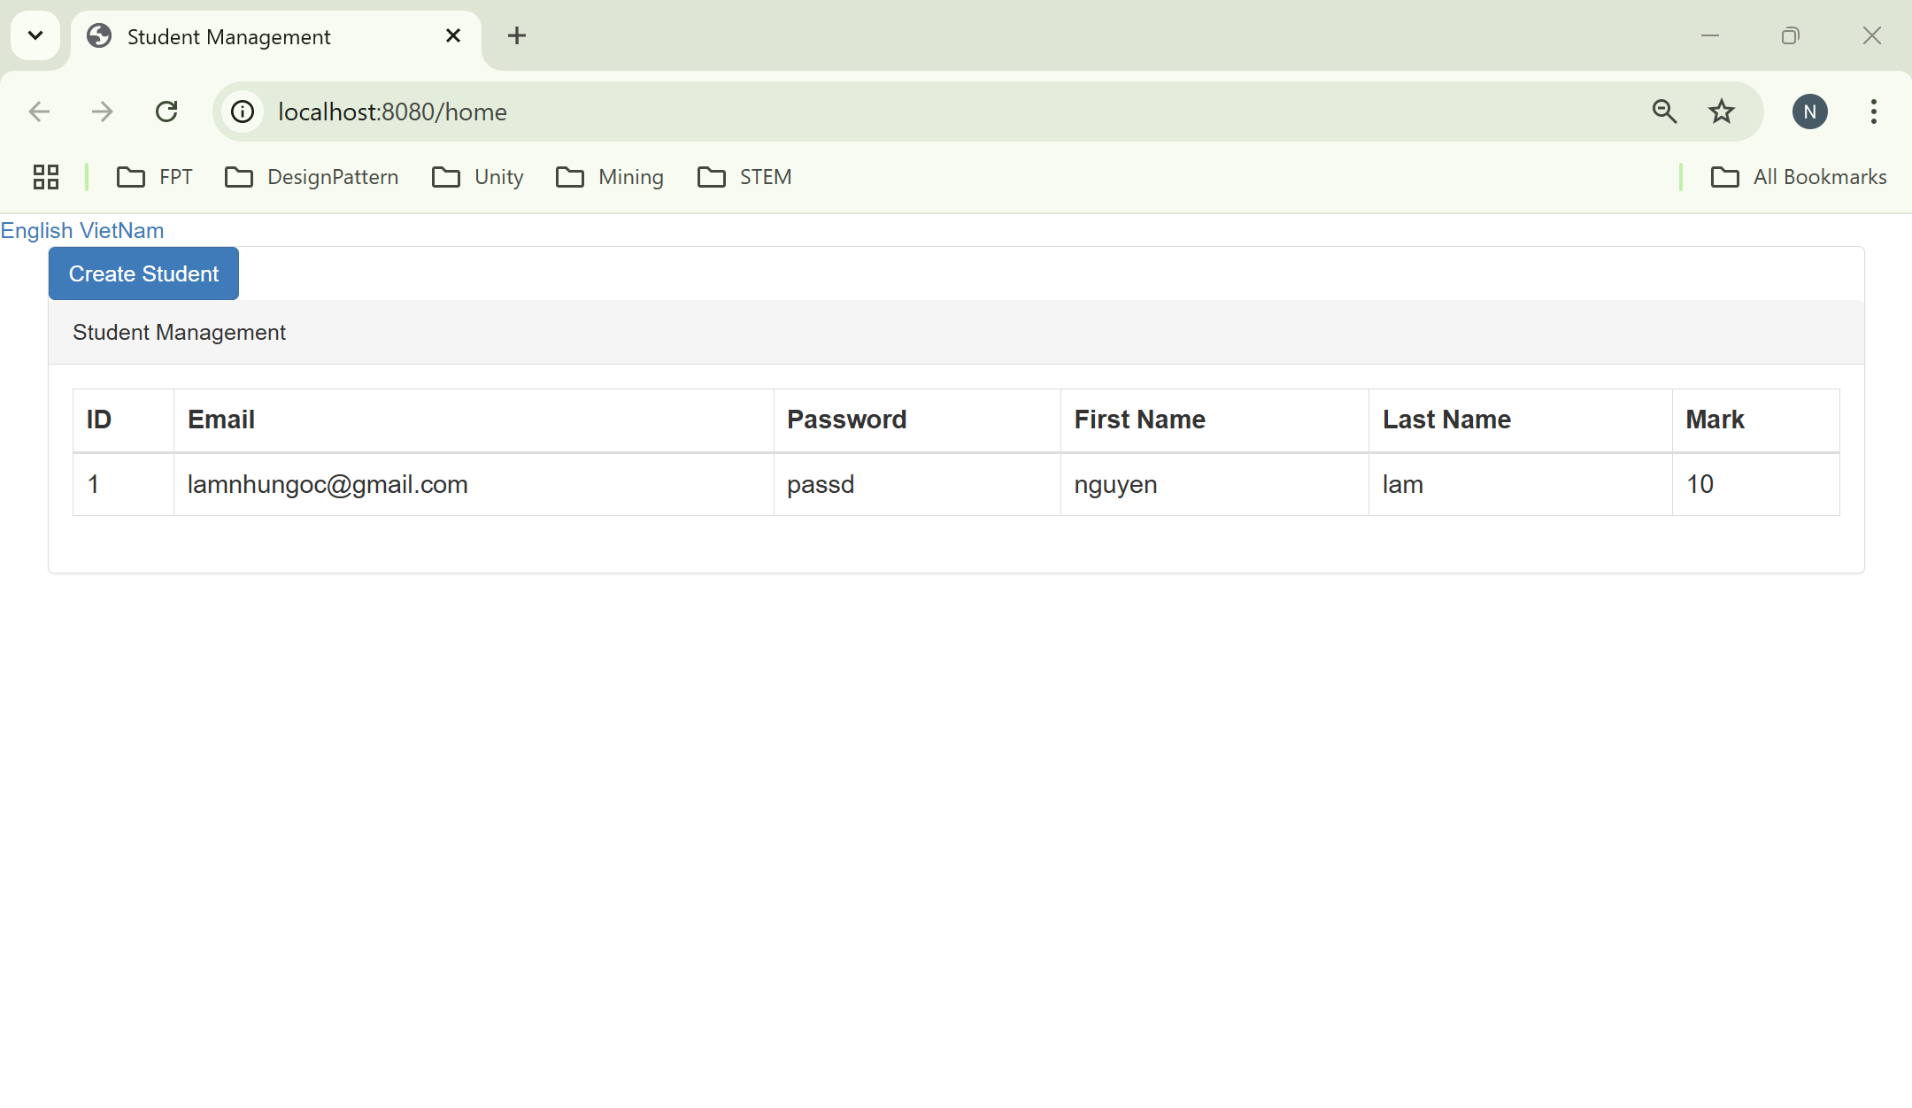
Run Program
1

Slide 70
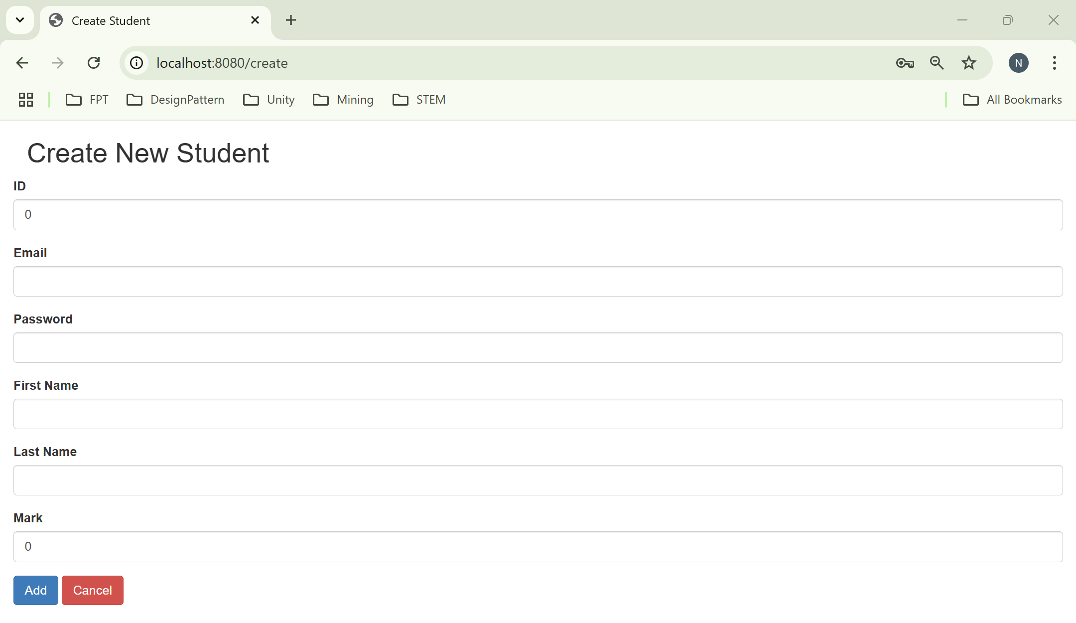
Run Program
1

Slide 71
Summary
Concepts were introduced:
Spring MVC Basics
Spring MVC Framework
Controller/Model/View
Spring Interceptor
Spring Validator

